Slide 1

ARREOS INTERNATIONAL
88/384 (3) Overseas Compound, Humanyun Bagh, Kanpur 208001, Uttar Pardesh – INDIA
e-mail: info@arreosinternational.com, web: www.arreosinternational.com

Slide 2
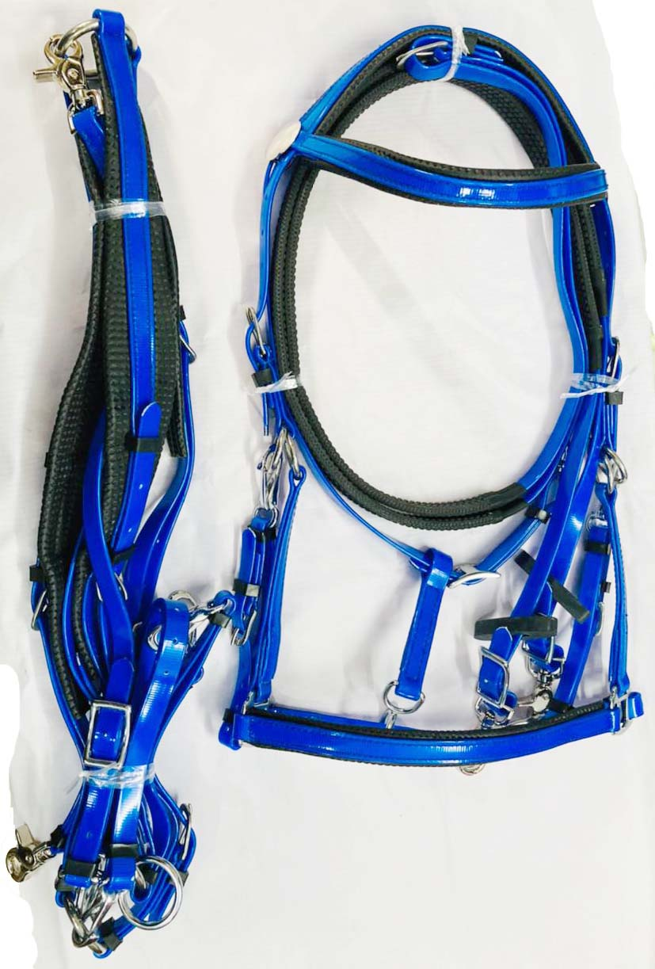
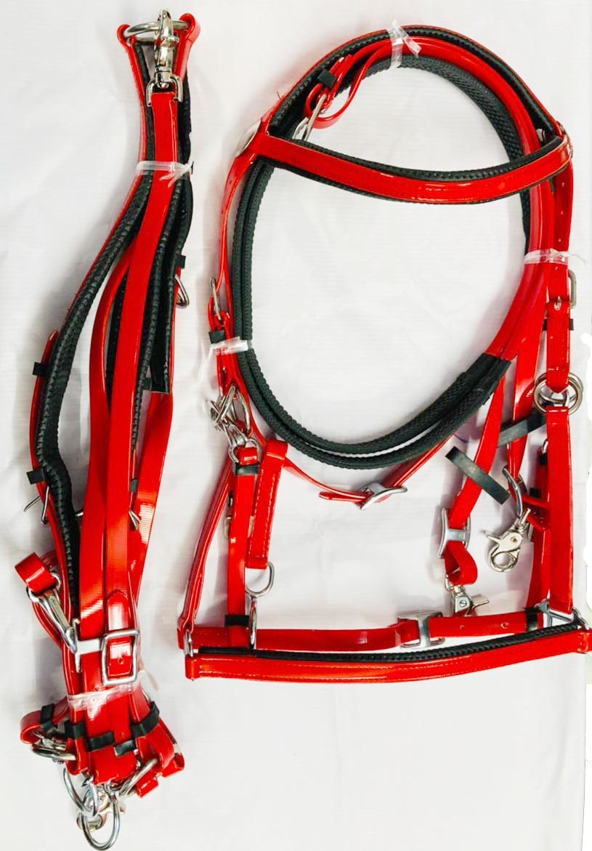
Endurance Bridle Set-EB-001, This adjustable halter-bridle combination features bit hangers that easily unsnap from the headstall to quickly convert from bridle to halter.
Features: patented synthetic material is durable, will not stretch, crack, fade or discolor Specially designed black PVC Waffle material along poll and noseband disperses pressure evenly for added comfort Stainless Steel buckles for years of hard use Maintenance free! Simply wash with warm water and soap Adjustable to fit Arab to full size horses.
RNG Biothane (tested & certified), Available in all colors, Size: Pony, Cob, Full.
Price: $28.25 FOB Mumbai Port, India With SS Fittings,
Price: $33.25 FOB Mumbai Port, India With Brass Fittings

Slide 3
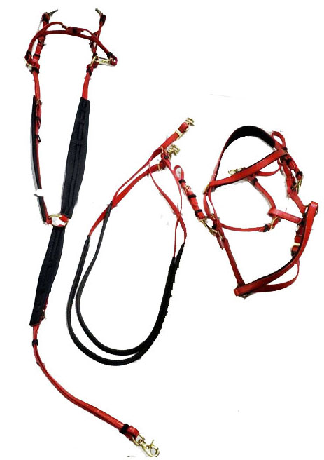
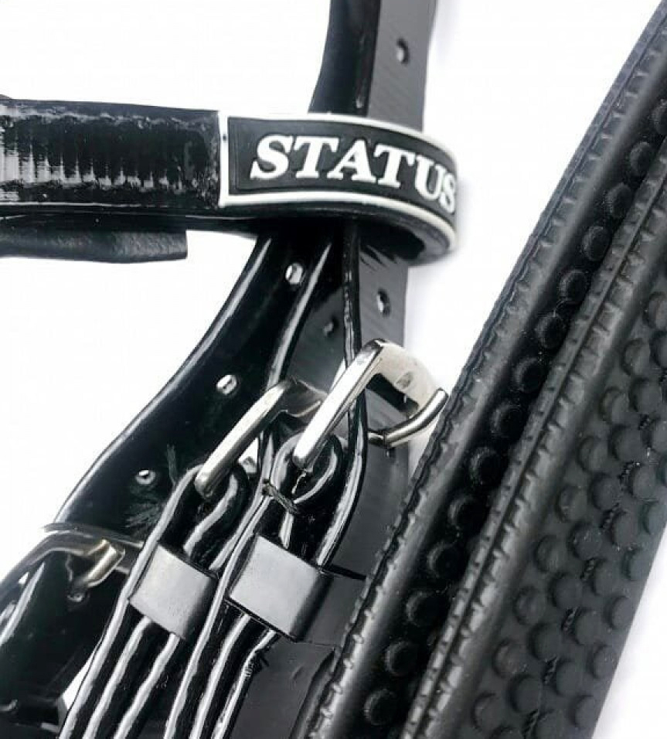
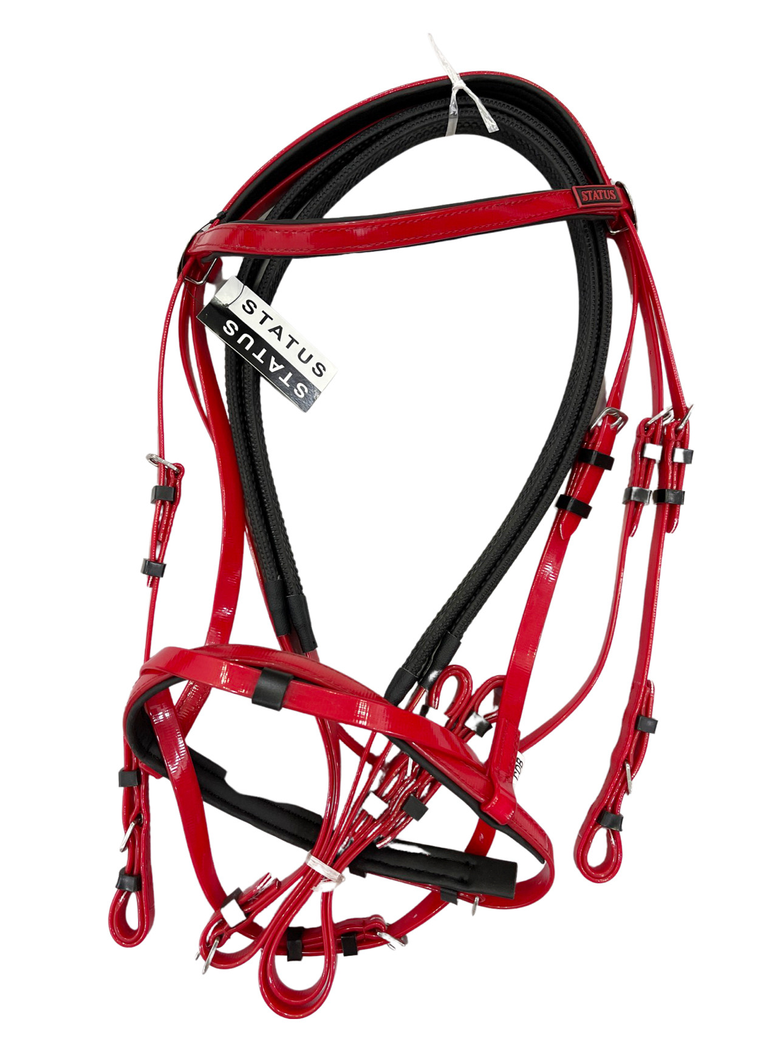
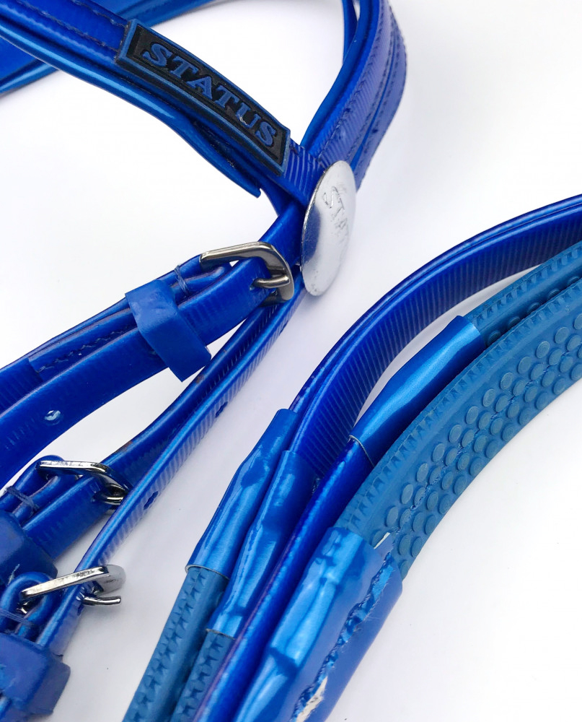
Endurance Bridle Set-EB-002, This adjustable halter-bridle combination features bit hangers that easily unsnap from the headstall to quickly convert from bridle to halter.
Features: patented synthetic material is durable, will not stretch, crack, fade or discolor Specially designed black PVC Waffle material along poll and noseband disperses pressure evenly for added comfort Stainless Steel buckles for years of hard use Maintenance free! Simply wash with warm water and soap Adjustable to fit Arab to full size horses.
RNG Biothane (tested & certified), Available in all colors, Size: Pony, Cob, Full.
Price: $27.25 FOB Mumbai Port, India, With SS Fittings
Price: $31.25 FOB Mumbai Port, India, With Brass Fittings

Slide 4
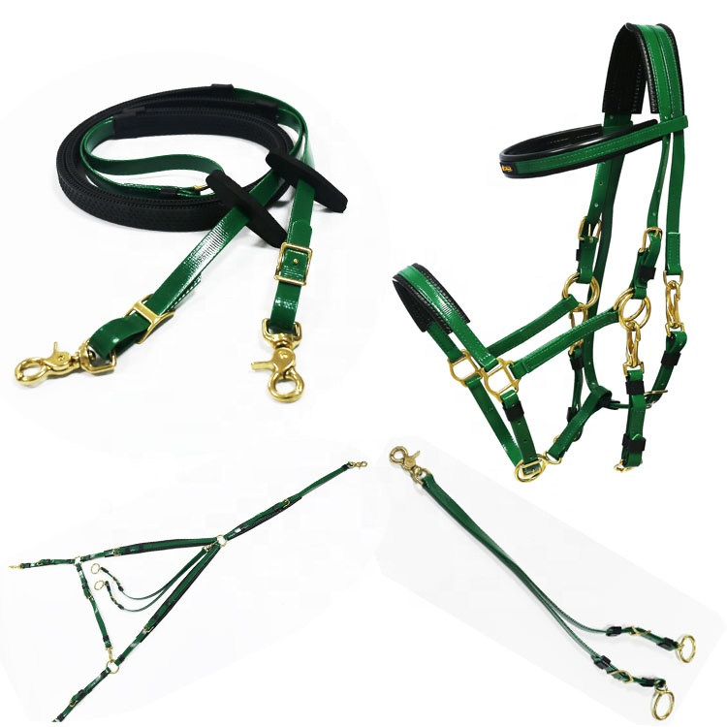
Endurance Bridle Set-EB-003, This adjustable halter-bridle combination features bit hangers that easily unsnap from the headstall to quickly convert from bridle to halter.
Features: patented synthetic material is durable, will not stretch, crack, fade or discolor Specially designed black PVC Waffle material along poll and noseband disperses pressure evenly for added comfort Brass Fittings (Heavy) for years of hard use Maintenance free! Simply wash with warm water and soap Adjustable to fit Arab to full size horses.
RNG Biothane (tested & certified), Available in all colors, Size: Pony, Cob, Full.
Price: $27.25 FOB Mumbai Port, India, With SS Fittings
Price: $31.25 FOB Mumbai Port, India, With Brass Fittings

Slide 5
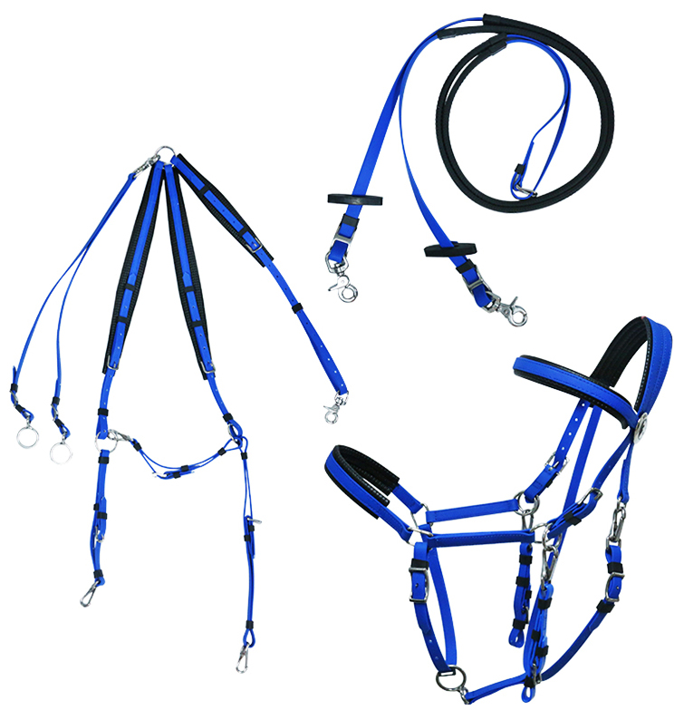
Endurance Bridle Set-EB-004, This adjustable halter-bridle combination features bit hangers that easily unsnap from the headstall to quickly convert from bridle to halter.
Features: patented synthetic material is durable, will not stretch, crack, fade or discolor Specially designed black PVC Waffle material along poll and noseband disperses pressure evenly for added comfort Stainless Steel buckles for years of hard use Maintenance free! Simply wash with warm water and soap Adjustable to fit Arab to full size horses.
RNG Biothane (tested & certified), Available in all colors, Size: Pony, Cob, Full.
Price: $27.25 FOB Mumbai Port, India, With SS Fittings
Price: $31.25 FOB Mumbai Port, India, With Brass Fittings

Slide 6
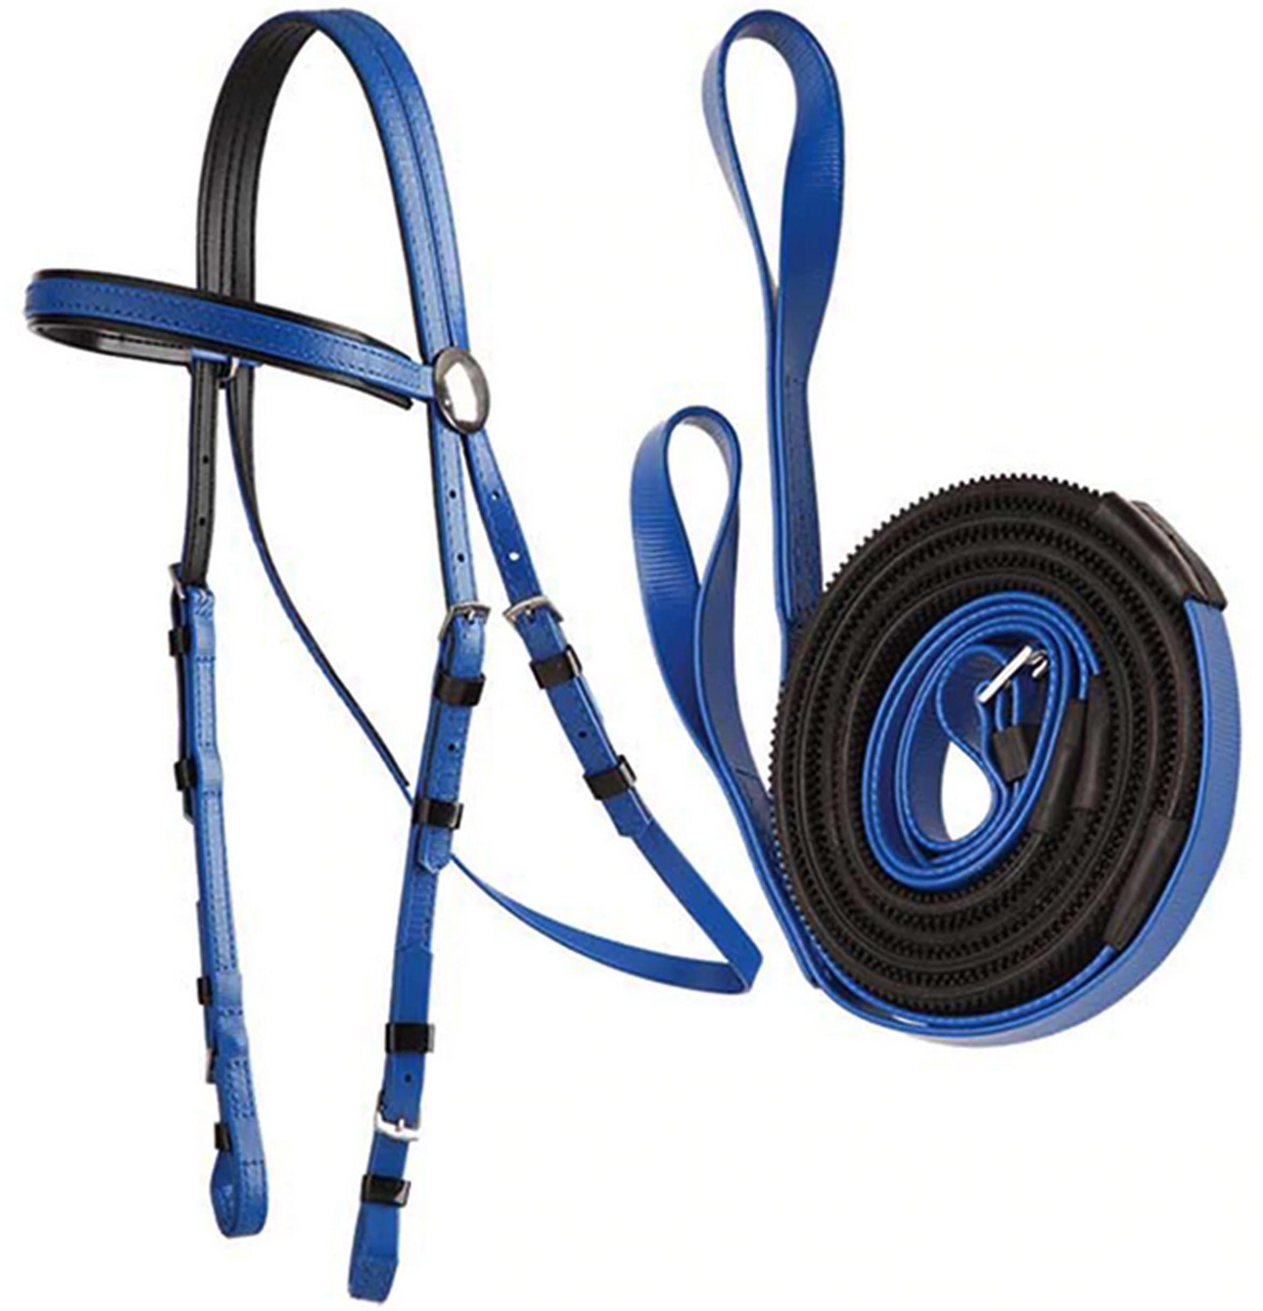
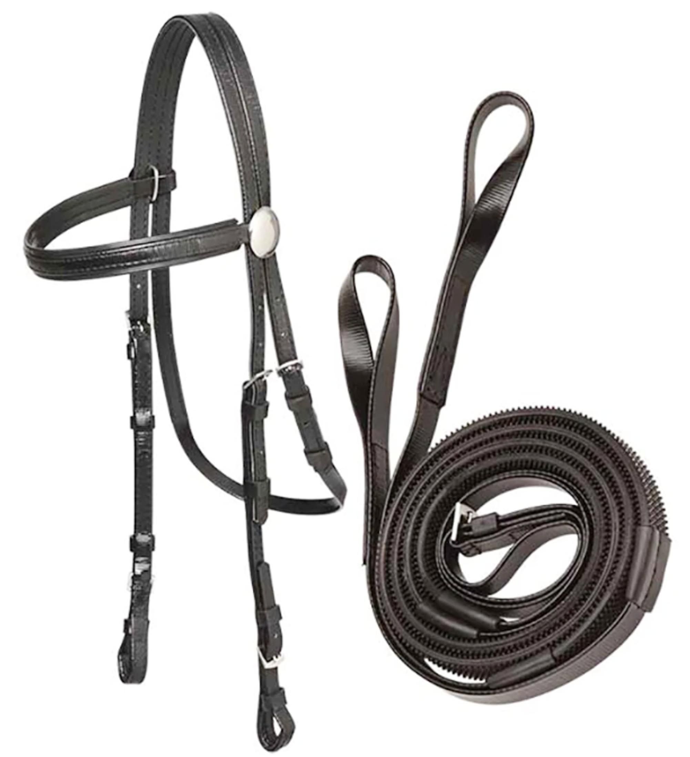
Racing Bridle Set-RCB-007-008 Flexible Fancy PVC And TPU Racing Horse Bridle With Double Noseband Set.
Features: patented synthetic material is durable, will not stretch, crack, fade or discolor Specially designed black PVC Waffle material along poll and noseband disperses pressure evenly for added comfort Stainless Steel buckles for years of hard use Maintenance free! Simply wash with warm water and soap Adjustable to fit Arab to full size horses.
RNG Biothane (tested & certified), Available in all colors, Size: Pony, Cob, Full.
Price: $19.25 With SS Fittings, Mumbai Port, India
Price: $25.25 With Brass Fittings, Mumbai Port, India

Slide 7
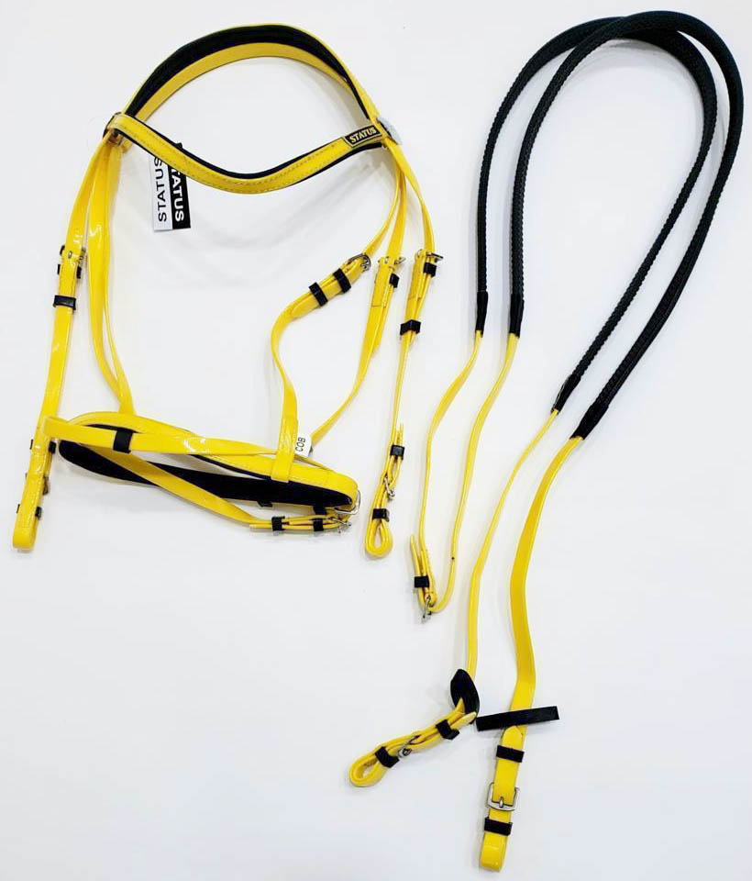
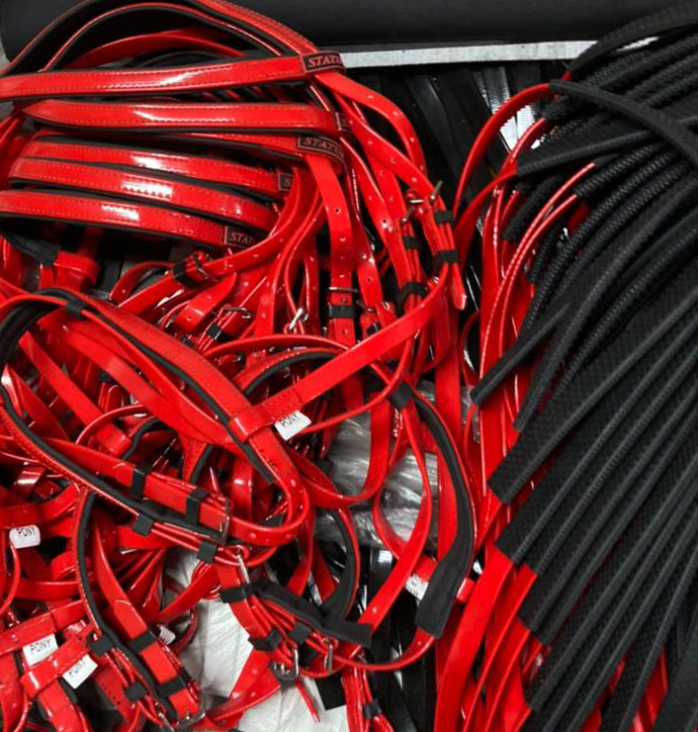
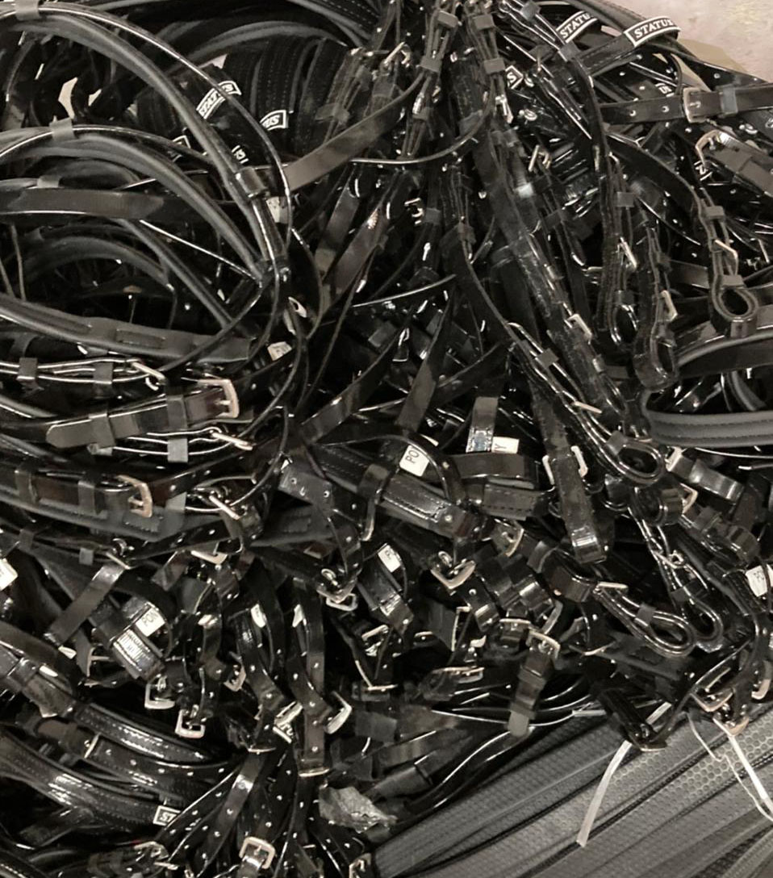
Racing Bridle Set-RCB-009 Flexible Fancy PVC And TPU Racing Horse Bridle With Double Noseband Set.
Features: patented synthetic material is durable, will not stretch, crack, fade or discolor Specially designed black PVC Waffle material along poll and noseband disperses pressure evenly for added comfort Stainless Steel buckles for years of hard use Maintenance free! Simply wash with warm water and soap Adjustable to fit Arab to full size horses.
RNG Biothane (tested & certified), Available in all colors, Size: Pony, Cob, Full.
Price: $19.25 With SS Fittings, Mumbai Port, India
Price: $25.25 With Brass Fittings, Mumbai Port, India

Slide 8
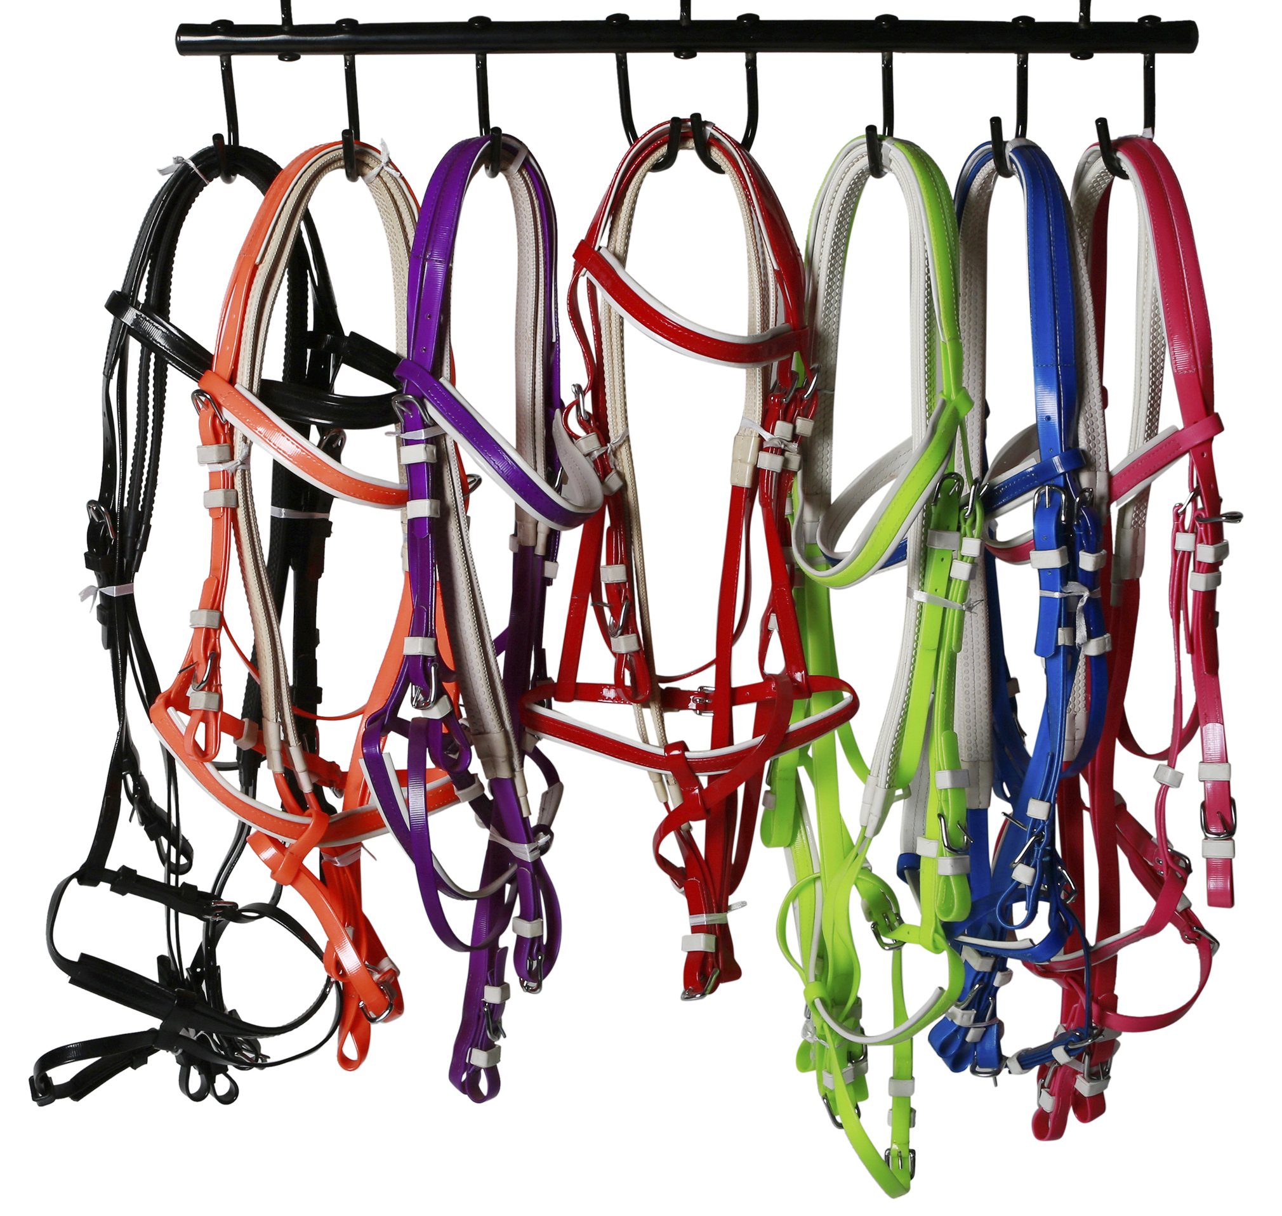
Colour Options

Slide 9
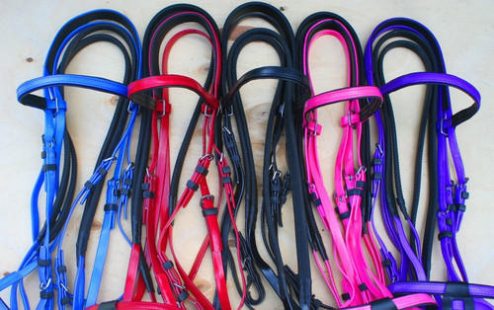
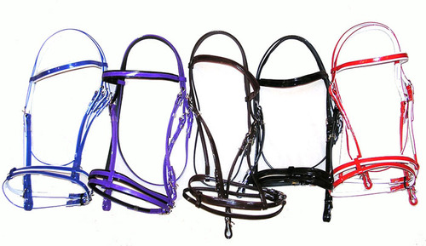
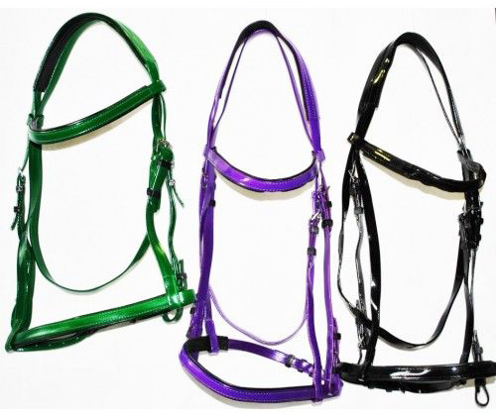
Colour Options

