Slide 1

ARREOS INTERNATIONAL
88/384 (3) Overseas Compound, Humanyun Bagh, Kanpur 208001, Uttar Pardesh – INDIA
e-mail: info@arreosinternational.com, web: www.arreosinternational.com

Slide 2
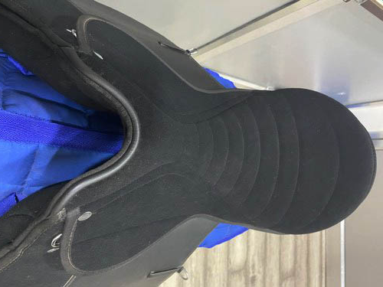
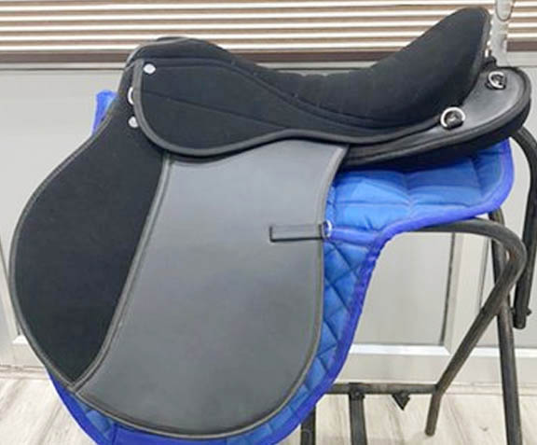
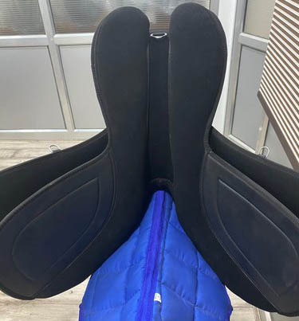
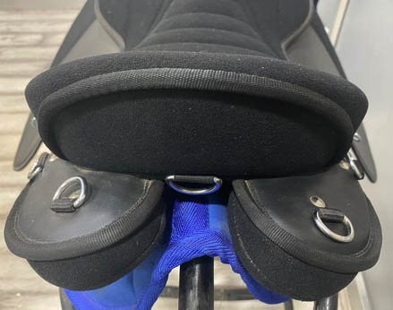
Endurance Saddle: EN-003
Lightweight synthetic endurance saddle synthetic suede ribbed seat and synthetic suede flaps.
Long wide panels to help distribute the riders weight
Soft feel fabric/Wooden seat and saddle flaps for comfort & grip
Colour: Black, Brown, SIZE : 14”, 15” 16", 17" & 18"
Price : USD – 51.50.00 FOB Mumbai Port, India

Slide 3
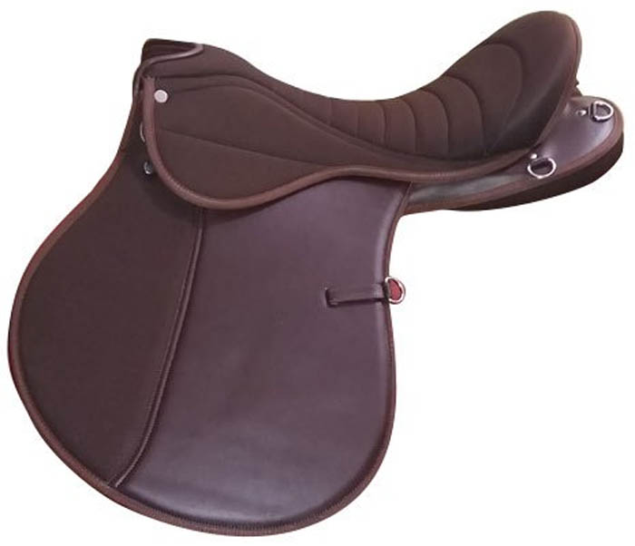
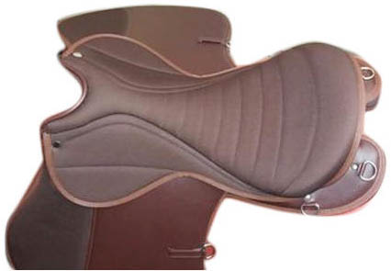
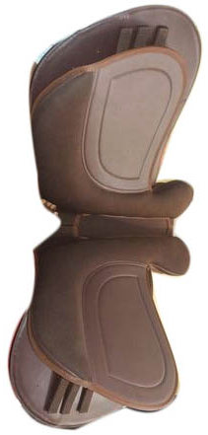
Endurance Saddle: EN-002
Lightweight synthetic endurance saddle synthetic suede ribbed seat and synthetic suede flaps.
Long wide panels to help distribute the riders weight
Soft feel fabric/Wooden seat and saddle flaps for comfort & grip
Colour: Black, Brown, SIZE : 14”, 15” 16", 17" & 18"
Price : USD – 56.50.00 FOB Mumbai Port, India

Slide 4
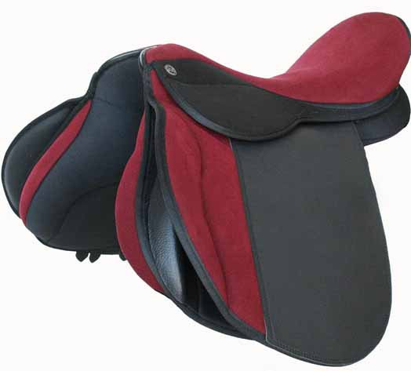
Endurance Saddle: EN-004
Lightweight synthetic endurance saddle synthetic suede ribbed seat and synthetic suede flaps.
Long wide panels to help distribute the riders weight
Soft feel fabric/Wooden seat and saddle flaps for comfort & grip
Colour: Black, Brown, SIZE : 14”, 15” 16", 17" & 18"
Price : USD – 56.50.00 FOB Mumbai Port, India

Slide 5
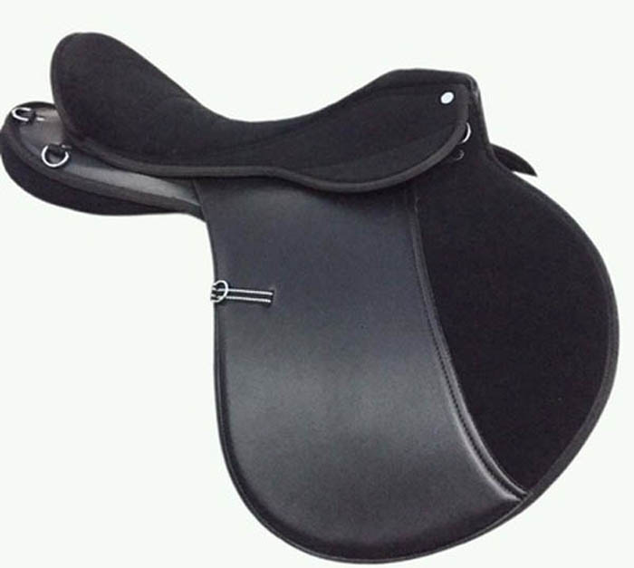
Endurance Saddle: EN-006
Lightweight synthetic endurance saddle synthetic suede ribbed seat and synthetic suede flaps.
Long wide panels to help distribute the riders weight
Soft feel fabric/Wooden seat and saddle flaps for comfort & grip
Colour: Black, Brown, SIZE : 14”, 15” 16", 17" & 18"
Price : USD – 49.50.00 FOB Mumbai Port, India

Slide 6
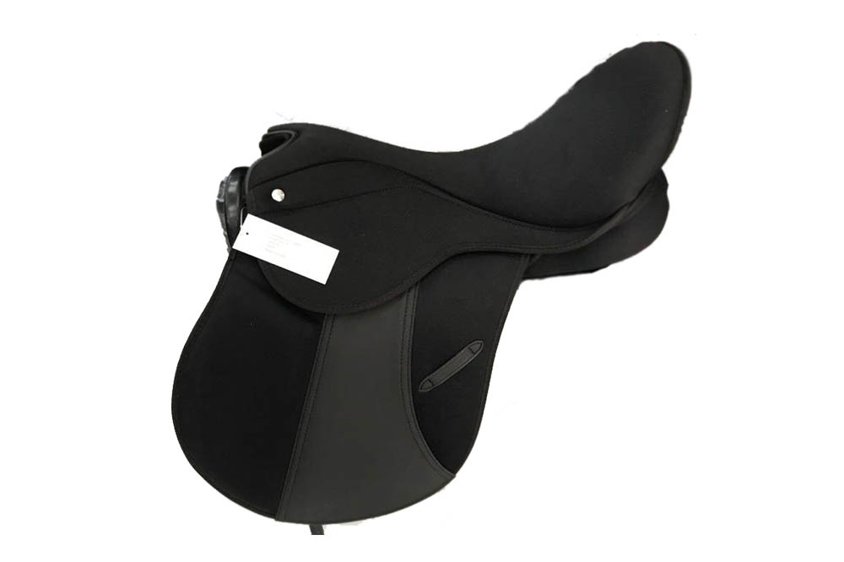
Endurance Saddle: EN-007
Lightweight synthetic endurance saddle synthetic suede ribbed seat and synthetic suede flaps.
Long wide panels to help distribute the riders weight
Soft feel fabric/Wooden seat and saddle flaps for comfort & grip
Colour: Black, Brown, SIZE : 14”, 15” 16", 17" & 18"
Price : USD – 56.50.00 FOB Mumbai Port, India

Slide 7
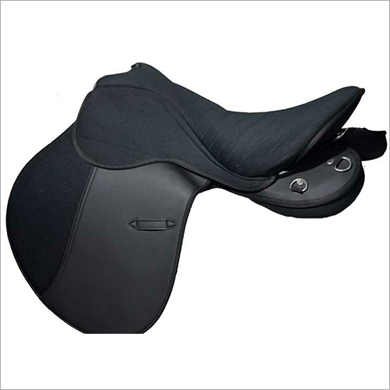
Endurance Saddle: EN-009
Lightweight synthetic endurance saddle synthetic suede ribbed seat and synthetic suede flaps.
Long wide panels to help distribute the riders weight
Soft feel fabric/Wooden seat and saddle flaps for comfort & grip
Colour: Black, Brown, SIZE : 14”, 15” 16", 17" & 18"
Price : USD – 53.50.00 FOB Mumbai Port, India

Slide 8
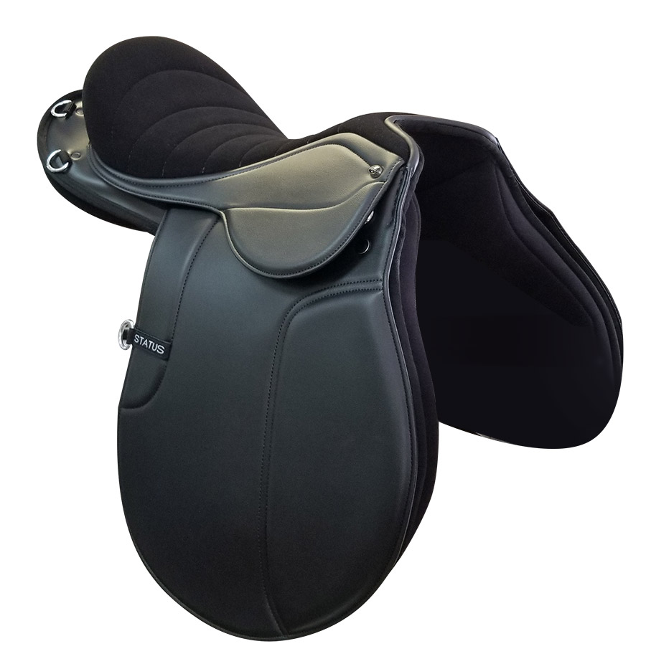
Endurance Saddle: EN-0010
Lightweight synthetic endurance saddle synthetic suede ribbed seat and synthetic suede flaps.
Long wide panels to help distribute the riders weight
Soft feel fabric/Wooden seat and saddle flaps for comfort & grip
Colour: Black, Brown, SIZE : 14”, 15” 16", 17" & 18"
Price : USD – 56.50.00 FOB Mumbai Port, India

Slide 9
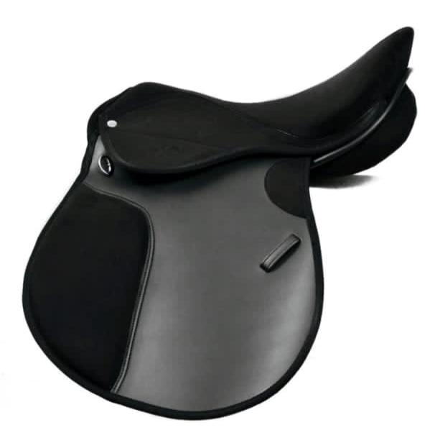
Endurance Saddle: EN-0011
Lightweight synthetic endurance saddle synthetic suede ribbed seat and synthetic suede flaps.
Long wide panels to help distribute the riders weight
Soft feel fabric/Wooden seat and saddle flaps for comfort & grip
Colour: Black, Brown, SIZE : 14”, 15” 16", 17" & 18"
Price : USD – 49.50.00 FOB Mumbai Port, India

Slide 10
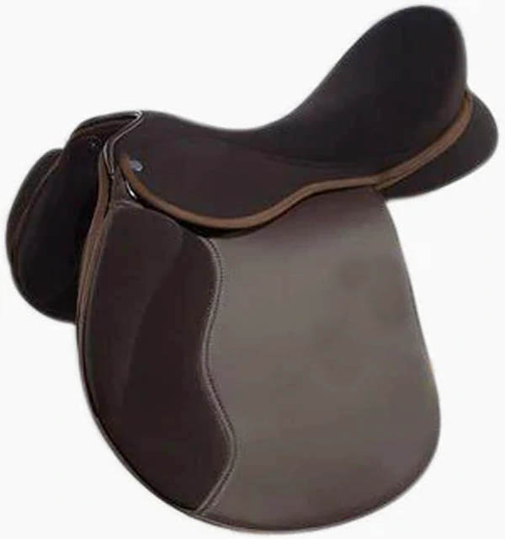
Endurance Saddle: EN-0012
Lightweight synthetic endurance saddle synthetic suede ribbed seat and synthetic suede flaps.
Long wide panels to help distribute the riders weight
Soft feel fabric/Wooden seat and saddle flaps for comfort & grip
Colour: Black, Brown, SIZE : 14”, 15” 16", 17" & 18"
Price : USD – 49.50.00 FOB Mumbai Port, India

Slide 11
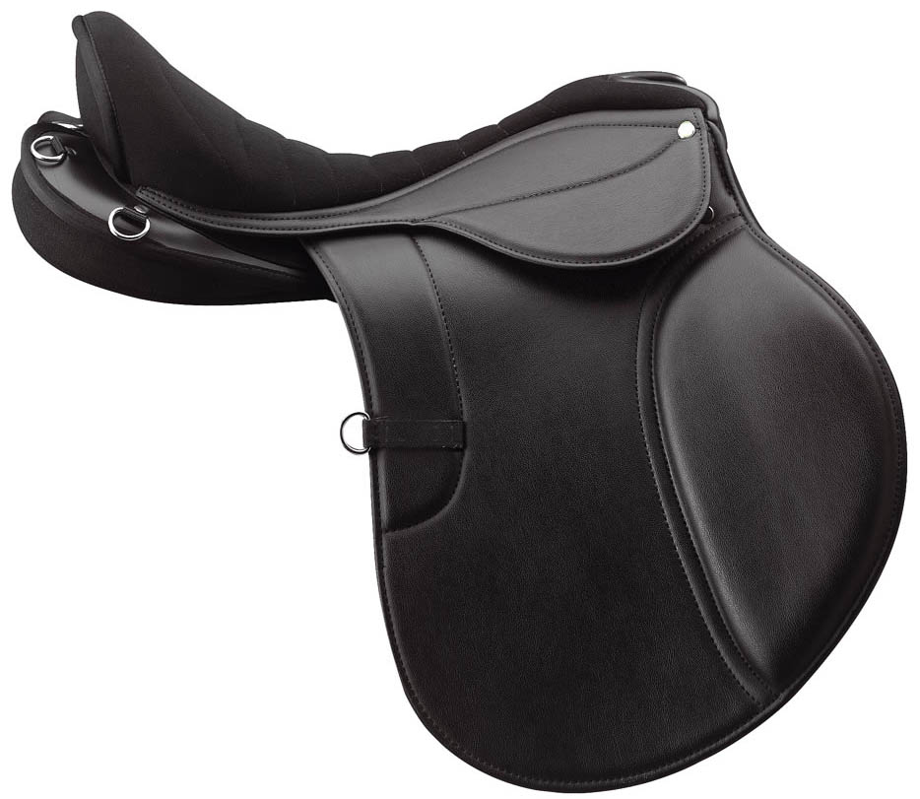
Endurance Saddle: EN-0013
Lightweight synthetic endurance saddle synthetic suede ribbed seat and synthetic suede flaps.
Long wide panels to help distribute the riders weight
Soft feel fabric/Wooden seat and saddle flaps for comfort & grip
Colour: Black, Brown, SIZE : 14”, 15” 16", 17" & 18"
Price : USD – 56.50.00 FOB Mumbai Port, India

Slide 12
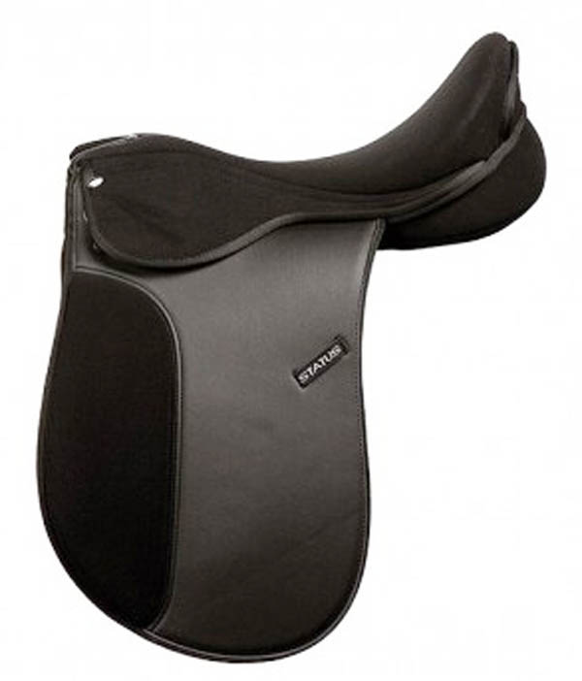
Endurance Dressage Saddle: EN-0014
Lightweight synthetic endurance saddle synthetic suede ribbed seat and synthetic suede flaps.
Long wide panels to help distribute the riders weight
Soft feel fabric/Wooden seat and saddle flaps for comfort & grip
Colour : Black, Brown, SIZE : 14”, 15” 16", 17" & 18"
Price : USD – 49.50.00 FOB Mumbai Port, India

Slide 13
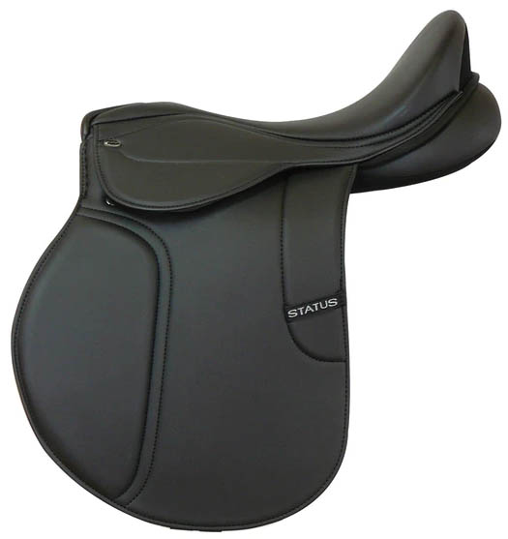
GP Saddle: EN-0015
Lightweight synthetic endurance saddle synthetic seat and synthetic flaps.
Long wide panels to help distribute the riders weight
Soft feel fabric/Wooden seat and saddle flaps for comfort & grip
Colour : Black, Brown, SIZE : 14”, 15” 16", 17" & 18"
Price : USD – 49.50.00 FOB Mumbai Port, India

