Slide 1

ARREOS INTERNATIONAL
88/384 (3) Overseas Compound, Humanyun Bagh, Kanpur 208001, Uttar Pardesh – INDIA
e-mail: info@arreosinternational.com, web: www.arreosinternational.com

Slide 2
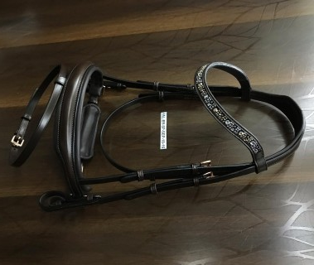
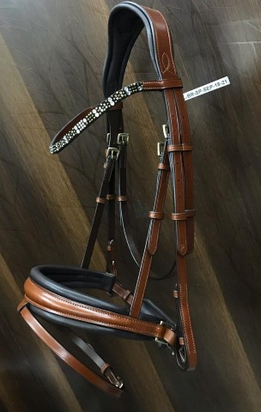
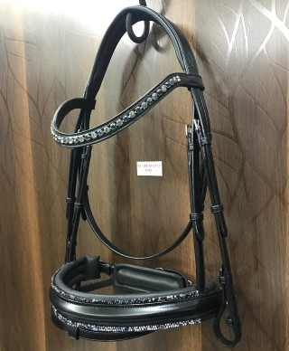
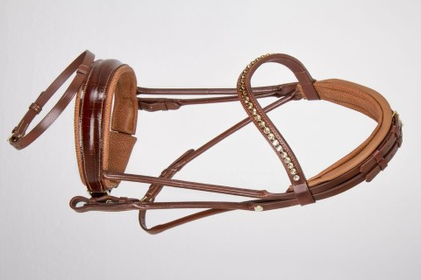
ENGLISH LEATHER DIAMANTE BRIDLE WITH SOFTY PADDED & DIAMANTE BROWBAND & TRIM (RUBBER REINS)
COLOURS AVAILABLE : BLACK, TAN & BROWN & SIZES : FULL, COB, PONY & SHETLAND
FOB MUMBAI PRICE : USD - 85.00

Slide 3
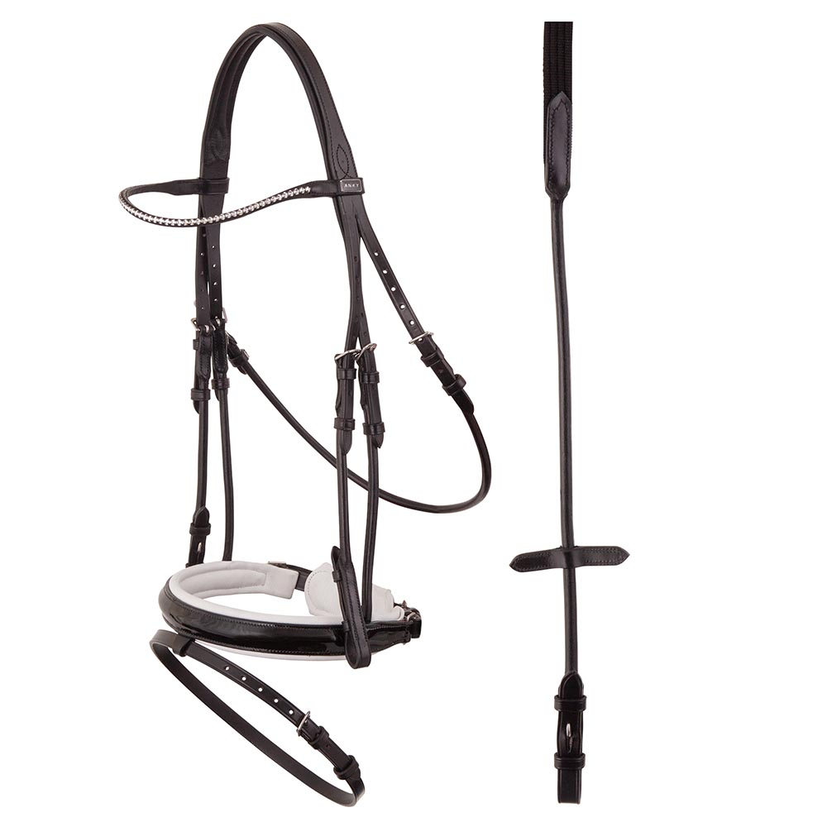
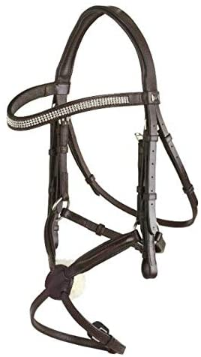
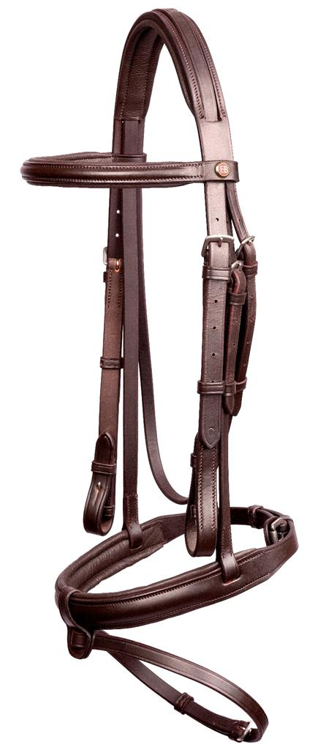
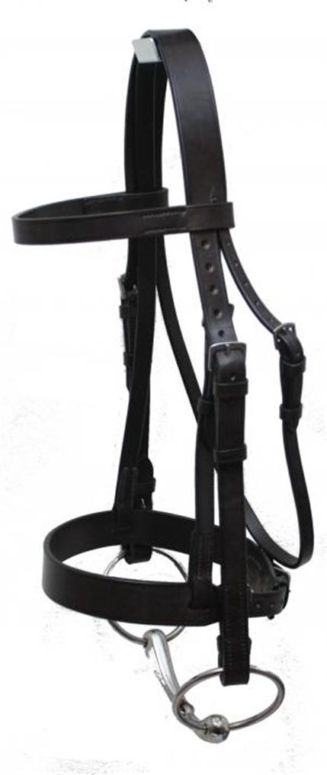
LEATHER DIAMANTE BRIDLE WITH SOFTY PADDED & DIAMANTE BROWBAND & TRIM (RUBBER REINS)
BUFF HARNESS LEATHER BRIDLE & HUNTER BRIDLE WITH RUBBER REINS & WEB REINS ON 25MM WITH SOFTY PADDED
COLOURS AVAILABLE : BLACK, TAN & BROWN & SIZES : FULL, COB, PONY & SHETLAND
FOB MUMBAI PRICE : DIAMANTE USD - 65.00, BRIDLE USD-45, HUNTER BRIDLE USD-40

Slide 4
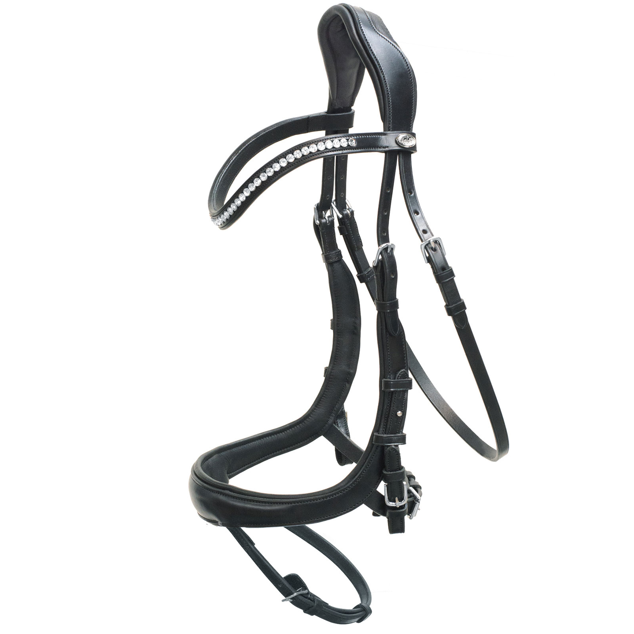
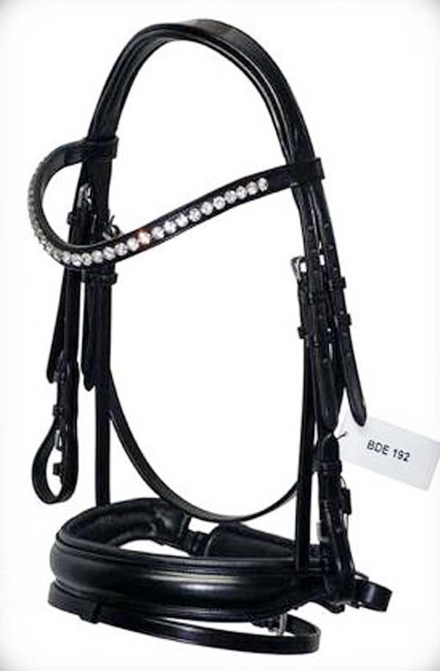
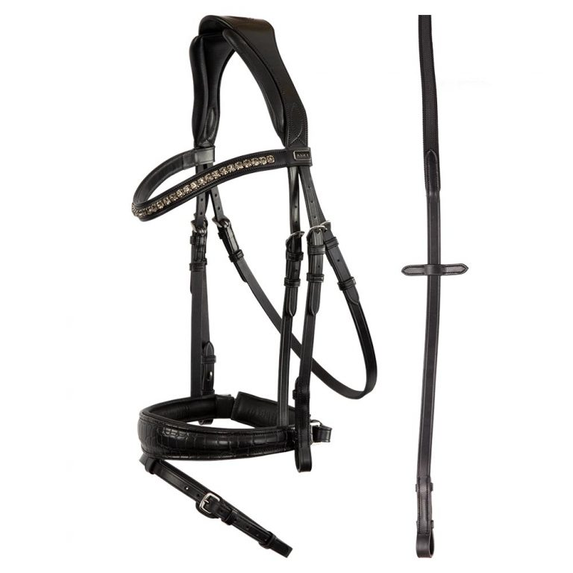
ENGLISH LEATHER DIAMANTE BRIDLE WITH SOFTY PADDED & DIAMANTE BROWBAND & TRIM (RUBBER REINS)
COLOURS AVAILABLE : BLACK, TAN & BROWN & SIZES : FULL, COB, PONY & SHETLAND
FOB MUMBAI PRICE : USD - 85.00

Slide 5
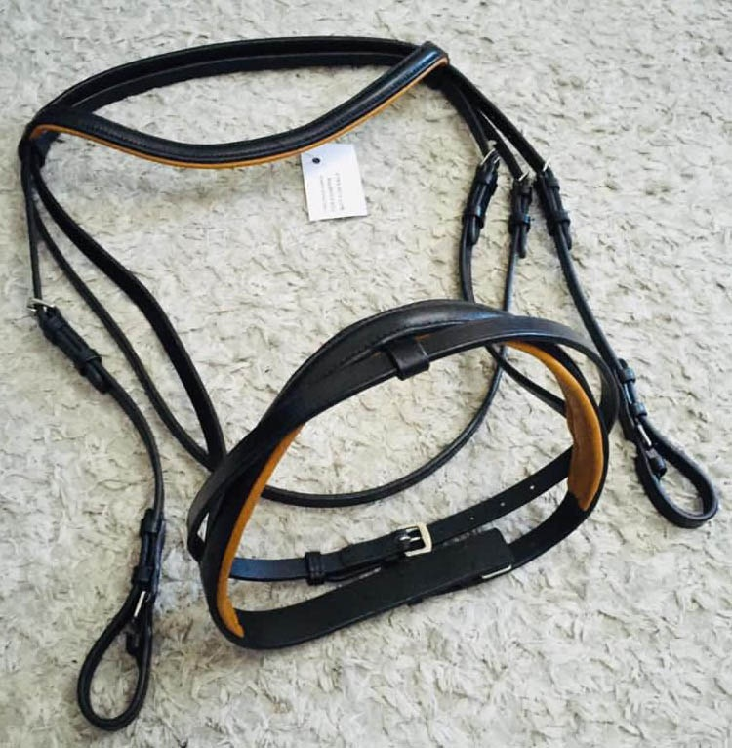
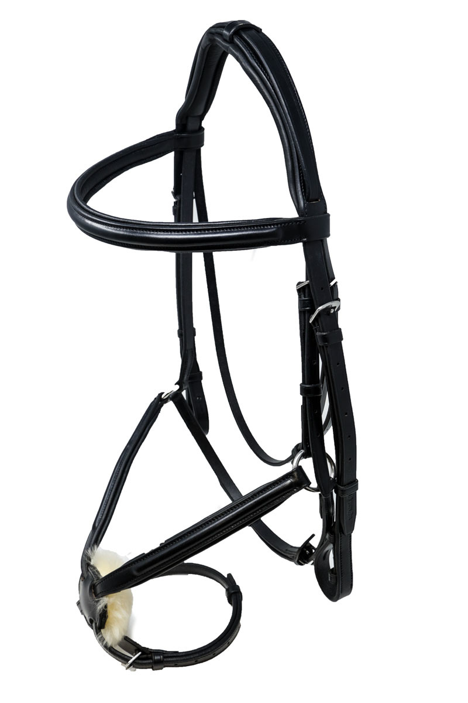
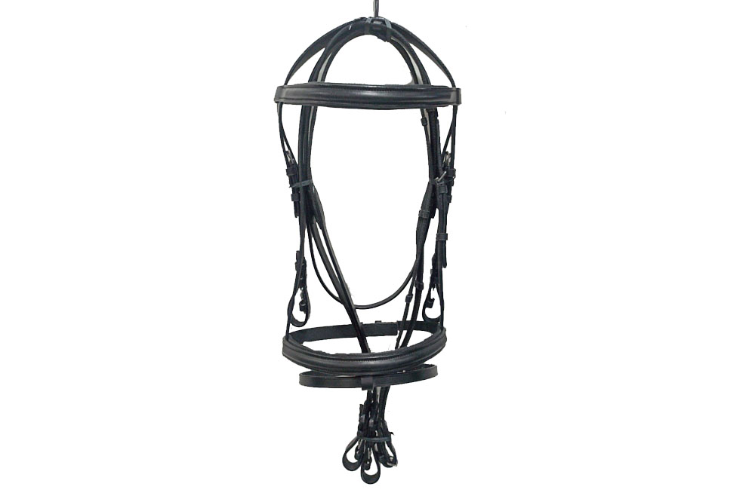
BUFF HARNESS LEATHER BRIDLE WITH RUBBER REINS & WEB REINS ON 25MM WITH SOFTY PADDED COLOURS AVAILABLE : BLACK & BROWN & SIZES : FULL, COB, PONY & SHETLAND
FOB MUMBAI PRICE : USD - 55.00

