Slide 1

ARREOS INTERNATIONAL
88/384 (3) Overseas Compound, Humanyun Bagh, Kanpur 208001, Uttar Pardesh – INDIA
e-mail: info@arreosinternational.com, web: www.arreosinternational.com

Slide 2
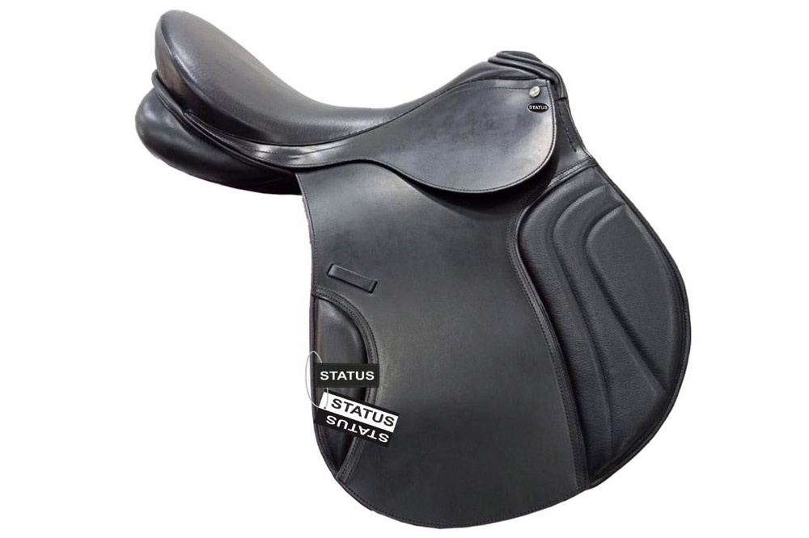
ARTICLE : ALL PURPOSE SADDLE JUMPING (AP-001)
DES: BUFFALO LEATHER HARNESS WITH COW SOFTY SOFT PADDED, WOODEN TREE
COLOUR : BLACK, BROWN SIZE : 14”, 15” 16", 17" & 18"
FOB MUMBAI PRICE : USD - 65.00

Slide 3
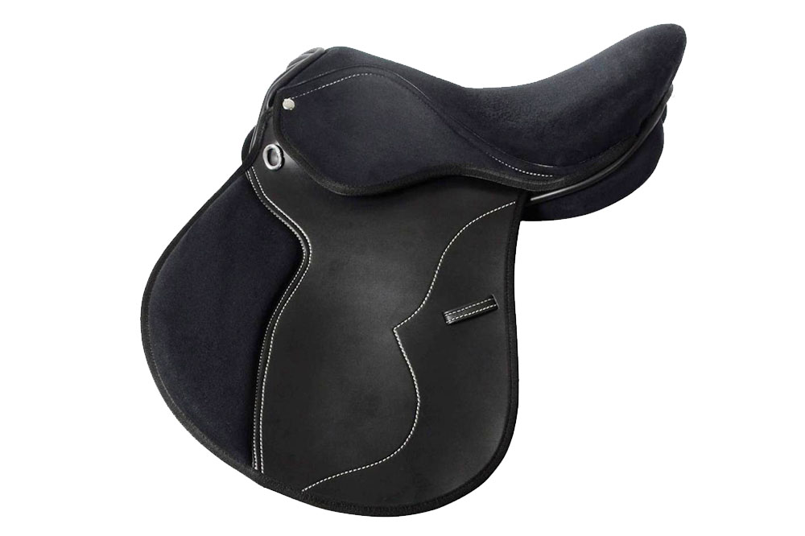
SYNTHETIC HALFLINGER GENERAL PURPOSE SADDLE (AP-002)
Beautifully stitched, comfortable half linger saddle. Can be used in all weather condition.
Wide fit - D-D 9inchs, Extra comfortable seat, Stainless Steel Fitting
COLOUR : BLACK, BROWN SIZE : 14”, 15” 16", 17" & 18"
FOB MUMBAI PRICE : USD - 42.00

Slide 4
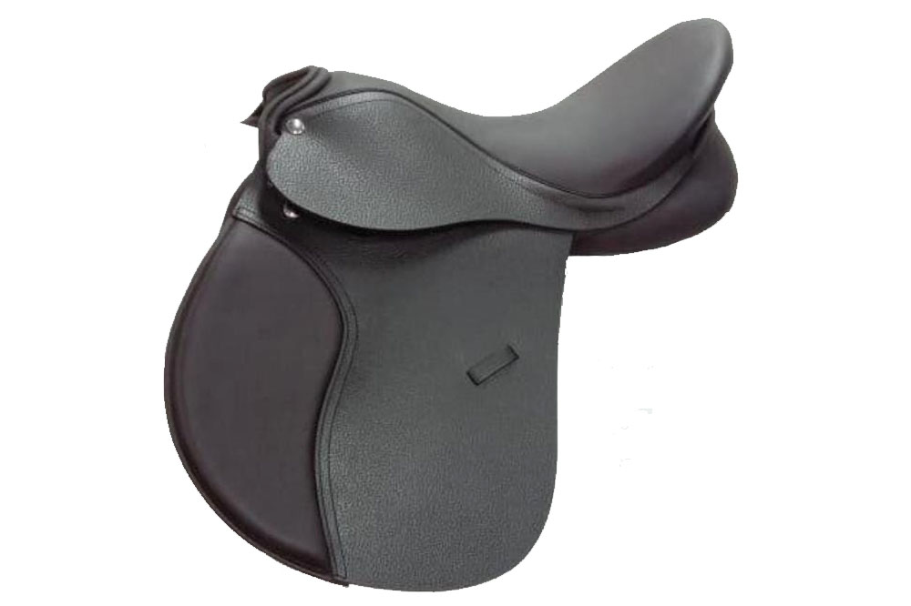
ARTICLE : ALL PURPOSE SADDLE (AP-003)
DES: BUFFALO LEATHER HARNESS WITH COW SOFTY SOFT PADDED, WOODEDN TREE
COLOUR : BLACK, BROWN SIZE : 14”, 15”, 16", 17" & 18"
FOB MUMBAI PRICE : USD - 65.00

Slide 5
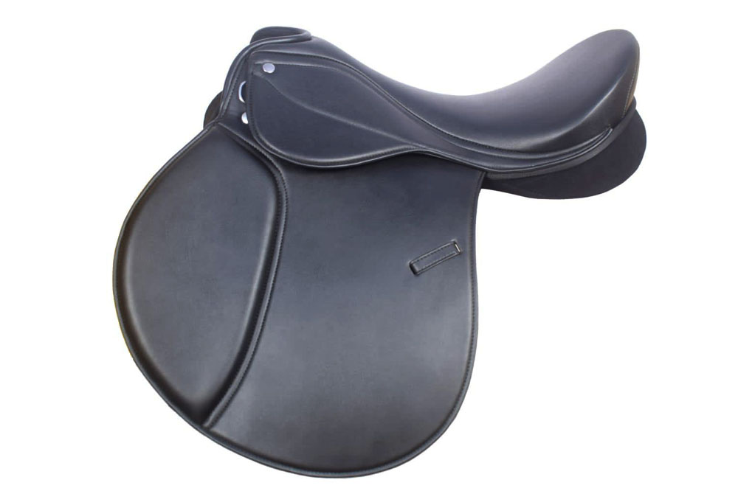
SYNTHETIC HALFLINGER GENERAL PURPOSE SADDLE (AP-004)
Beautifully stitched, comfortable half linger saddle. Can be used in all weather condition.
Wide fit - D-D 9inchs, Extra comfortable seat, Stainless Steel Fitting
COLOUR : BLACK, BROWN SIZE : 14”, 15” 16", 17" & 18"
FOB MUMBAI PRICE : USD - 40.00

Slide 6
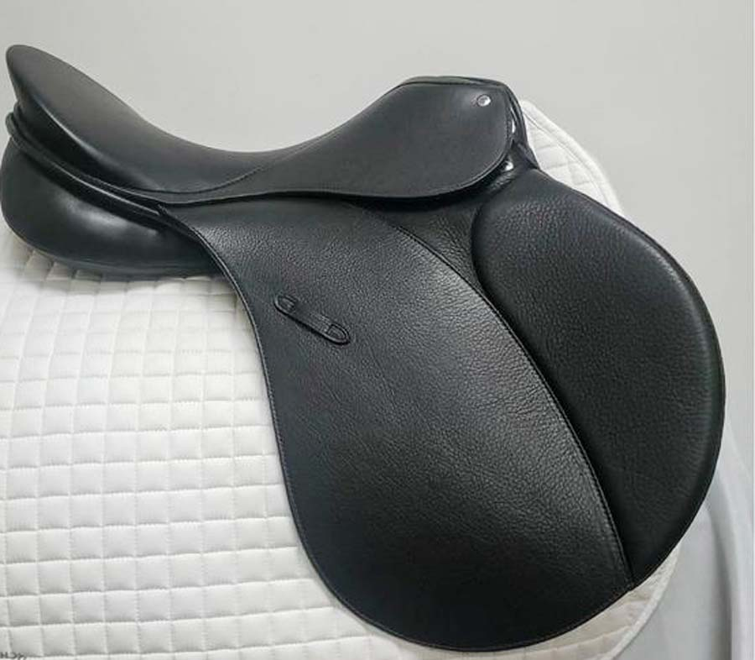
ARTICLE : ALL PURPOSE SADDLE (AP-005)
DES: IMPORTED COW HARNESS (ENGLISH LEATHER) WITH COW SOFTY SOFT PADDED, WOODEN TREE
COLOUR : BLACK, BROWN SIZE : 14”, 15” 16", 17" & 18"
FOB MUMBAI PRICE : USD - 95.00

Slide 7
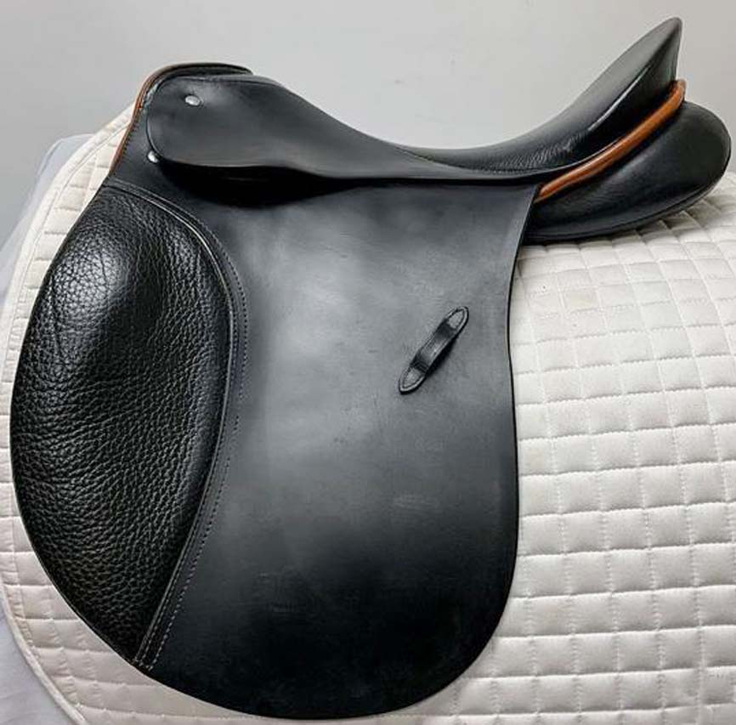
ARTICLE : SADDLE (AP-006)
DES: IMPORTED COW HARNESS (ENGLISH LEATHER) WITH COW SOFTY SOFT PADDED, WOODEN TREE
COLOUR : BLACK, BROWN SIZE : 14”, 15” 16", 17" & 18"
FOB MUMBAI PRICE : USD - 105.00

Slide 8
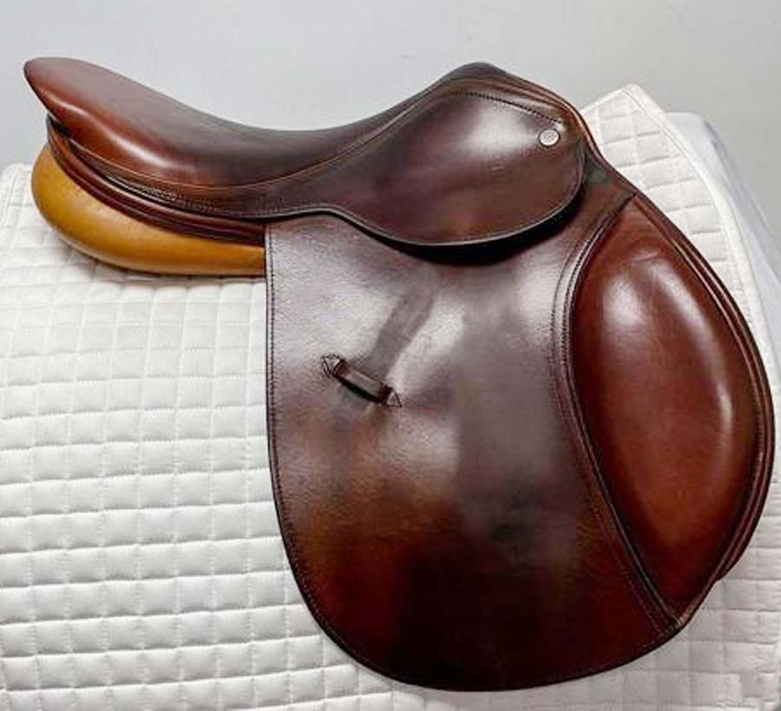
ARTICLE : SADDLE (AP-007)
DES: IMPORTED COW HARNESS (ENGLISH LEATHER) WITH COW SOFTY SOFT PADDED, WOODEN TREE
COLOUR : BLACK, BROWN SIZE : 14”, 15” 16", 17" & 18"
FOB MUMBAI PRICE : USD - 120.00

Slide 9
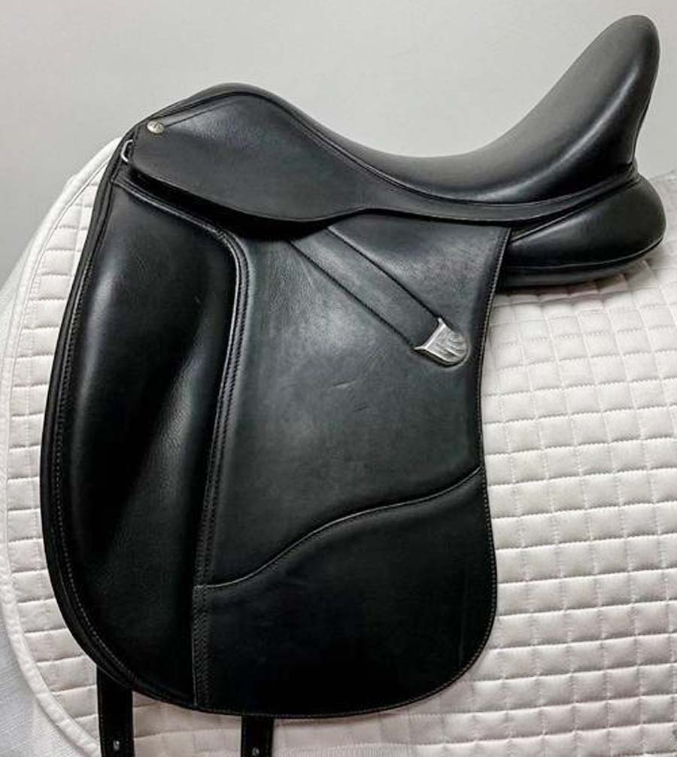
ARTICLE : SADDLE (AP-008)
DES: IMPORTED COW HARNESS (ENGLISH LEATHER) WITH COW SOFTY SOFT PADDED, WOODEN TREE
COLOUR : BLACK, BROWN SIZE : 14”, 15” 16", 17" & 18"
FOB MUMBAI PRICE : USD - 110.00

Slide 10
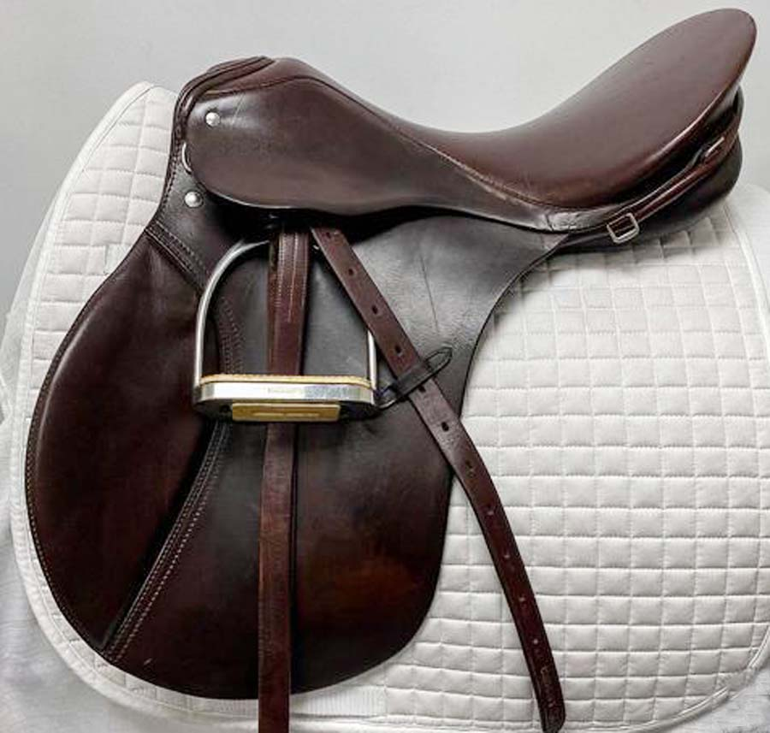
ARTICLE : SADDLE (AP-009)
DES: IMPORTED COW HARNESS (ENGLISH LEATHER) WITH COW SOFTY SOFT PADDED, WOODEN TREE
COLOUR : BLACK, BROWN SIZE : 14”, 15” 16", 17" & 18"
FOB MUMBAI PRICE : USD - 120.00

Slide 11
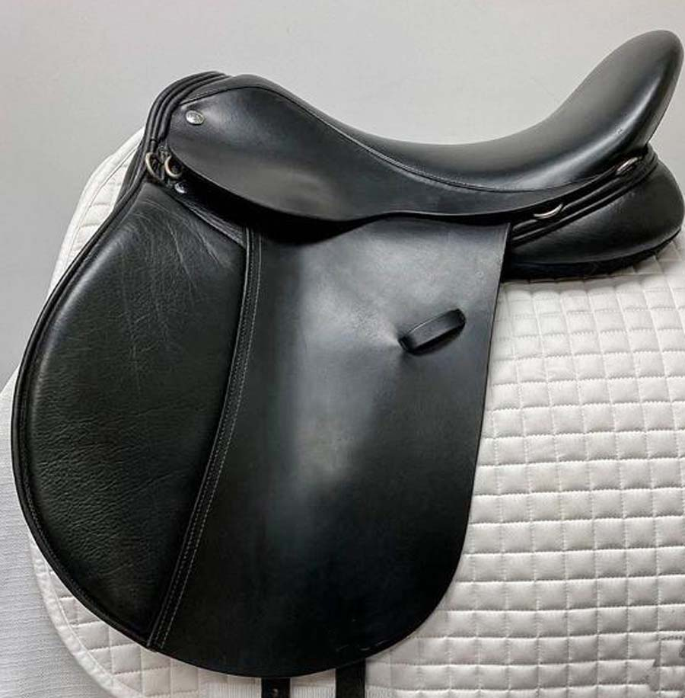
ARTICLE : SADDLE (AP-010)
DES: IMPORTED COW HARNESS (ENGLISH LEATHER) WITH COW SOFTY SOFT PADDED, WOODEN TREE
COLOUR : BLACK, BROWN SIZE : 14”, 15” 16", 17" & 18"
FOB MUMBAI PRICE : USD - 110.00

Slide 12
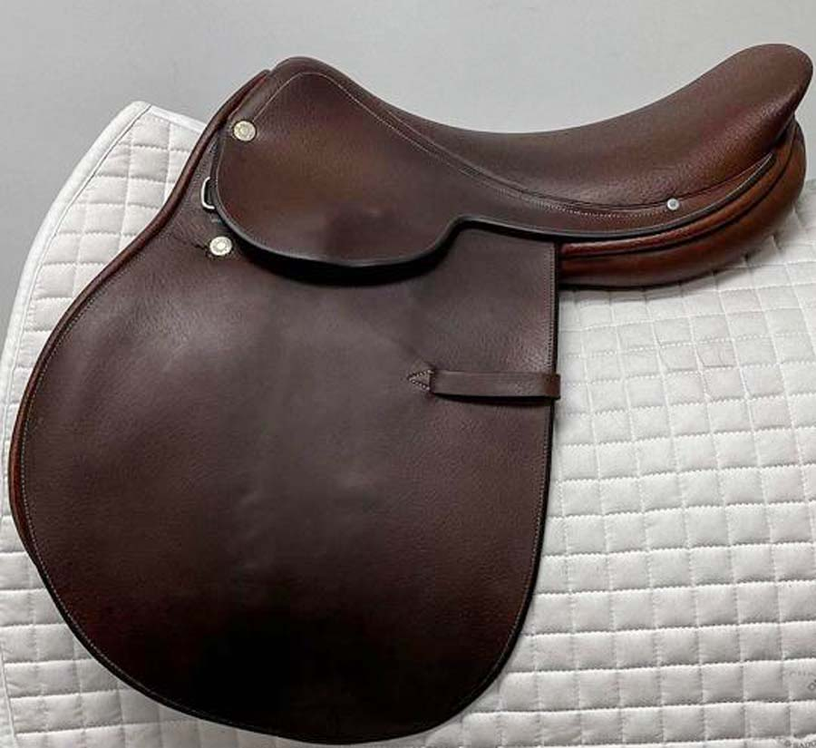
ARTICLE : SADDLE (AP-011)
DES: IMPORTED COW HARNESS (ENGLISH LEATHER) WITH COW SOFTY SOFT PADDED, WOODEN TREE
COLOUR : BLACK, BROWN SIZE : 14”, 15” 16", 17" & 18"
FOB MUMBAI PRICE : USD - 115.00

Slide 13
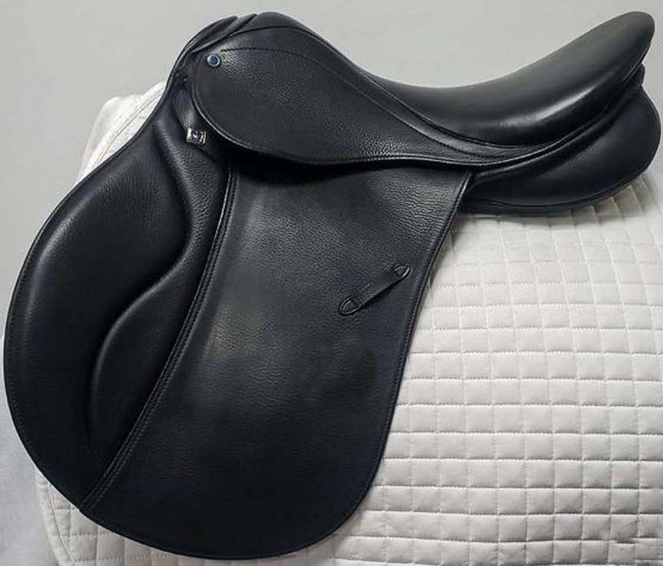
ARTICLE : SADDLE (AP-012)
DES: IMPORTED COW (ENGLISH LEATHER) COW SOFTY SOFT PADDED, WOODEN TREE
COLOUR : BLACK, BROWN SIZE : 14”, 15” 16", 17" & 18"
FOB MUMBAI PRICE : USD - 105.00

Slide 14
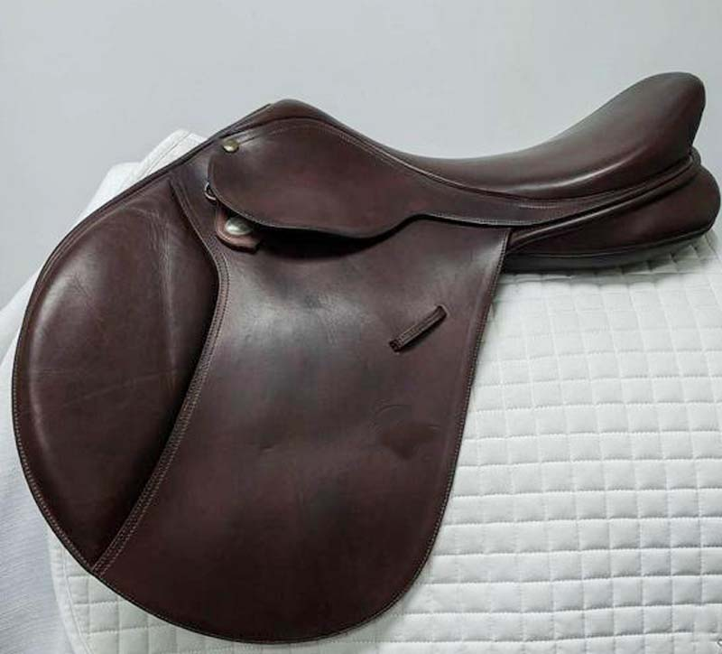
ARTICLE : SADDLE (AP-013)
DES: IMPORTED COW HARNESS (ENGLISH LEATHER) WITH COW SOFTY SOFT PADDED, WOODEN TREE
COLOUR : BLACK, BROWN SIZE : 14”, 15” 16", 17" & 18"
FOB MUMBAI PRICE : USD - 120.00

Slide 15
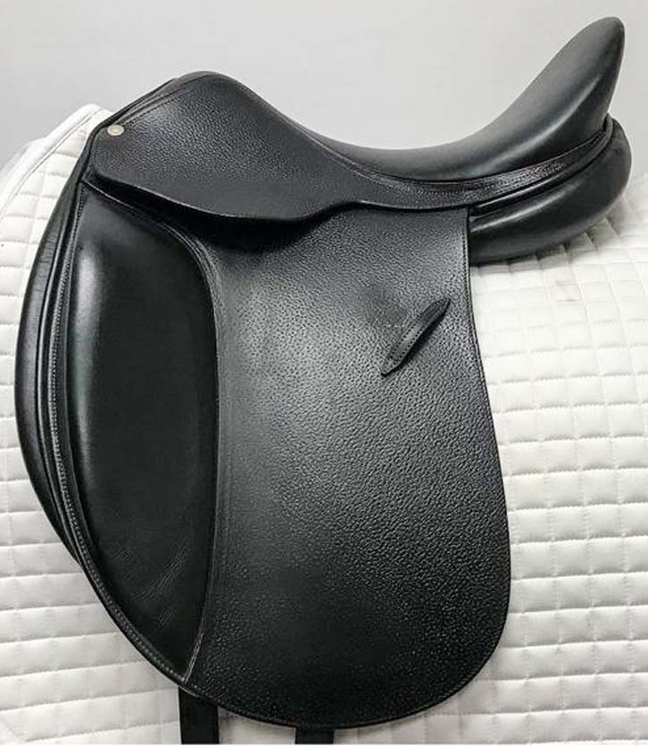
ARTICLE : SADDLE (AP-014)
DES: IMPORTED COW HARNESS (ENGLISH LEATHER) WITH COW SOFTY SOFT PADDED, WOODEN TREE
COLOUR : BLACK, BROWN SIZE : 14”, 15” 16", 17" & 18"
FOB MUMBAI PRICE : USD - 110.00

Slide 16
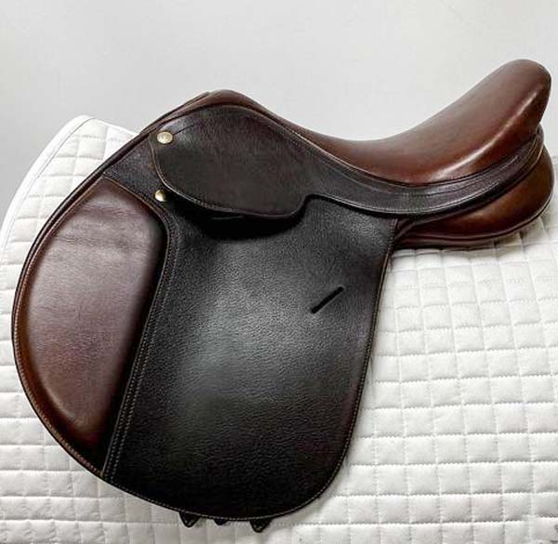
ARTICLE : SADDLE (AP-015)
DES: IMPORTED COW HARNESS (ENGLISH LEATHER) WITH COW SOFTY SOFT PADDED, WOODEN TREE
COLOUR : BLACK, BROWN SIZE : 14”, 15” 16", 17" & 18"
FOB MUMBAI PRICE : USD - 120.00

Slide 17
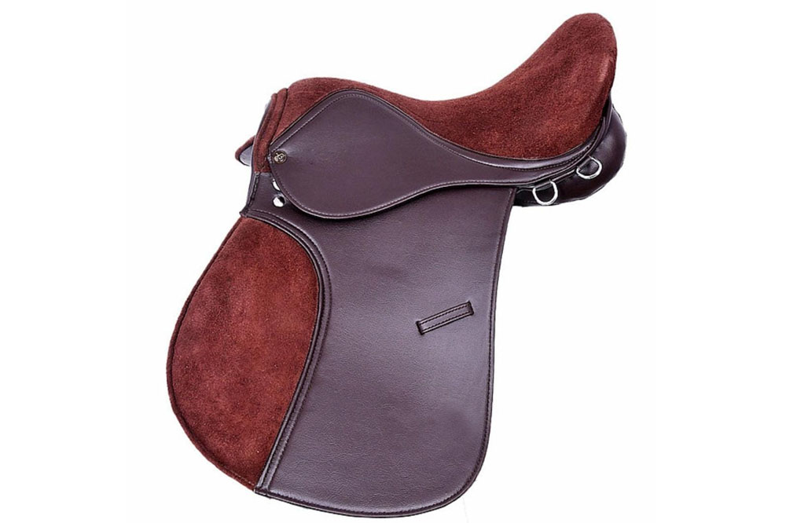
SYNTHETIC LEATHER HORSE SADDLE SUEDE SEAT & PAD (AP-016)
Beautifully stitched, comfortable half linger saddle. Can be used in all weather condition.
Wide fit -(SIZE-16,17,18) D-D 9inchs,(SIZE-14,15) D-D 7inchs,
Extra comfortable seat, Stainless Steel Fitting, COLOUR : BLACK, BROWN
FOB MUMBAI PRICE : USD - 45.00

Slide 18
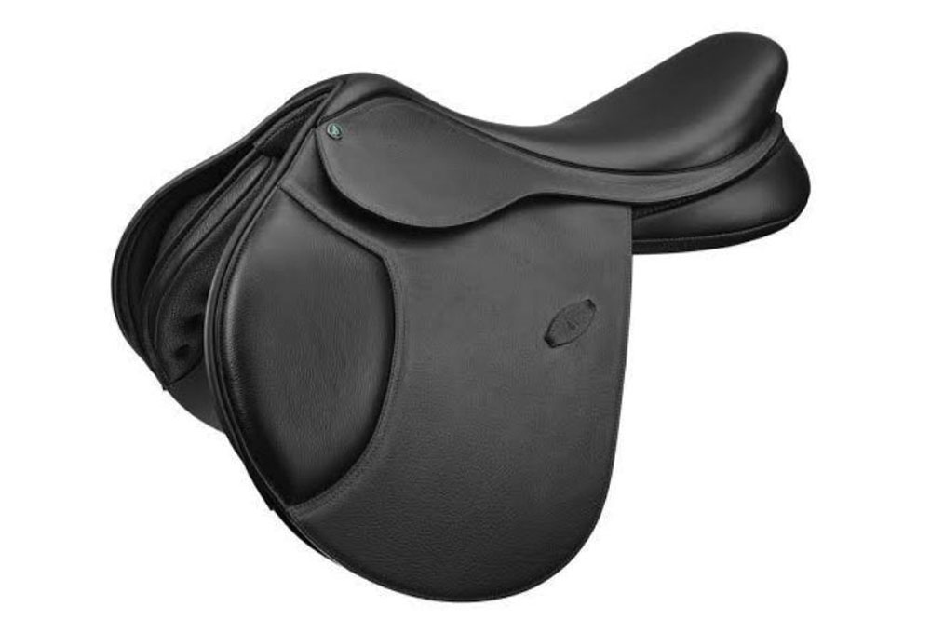
SYNTHETIC HALFLINGER GENERAL PURPOSE SADDLE (AP-017)
Beautifully stitched, comfortable half linger saddle. Can be used in all weather condition.
Wide fit - D-D 9inchs, Extra comfortable seat, Stainless Steel Fitting
FOB MUMBAI PRICE : USD - 45.00

Slide 19
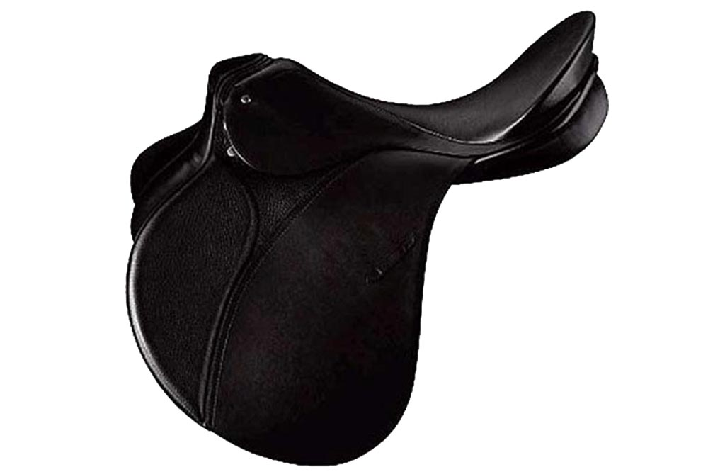
ARTICLE : ALL PURPOSE SADDLE (AP-018)
DES: BUFFALO LEATHER HARNESS WITH COW SOFTY SOFT PADDED, WOODEDN TREE
COLOUR : BLACK, BROWN SIZE : 16",17" & 18"
FOB MUMBAI PRICE : USD - 65.00

Slide 20
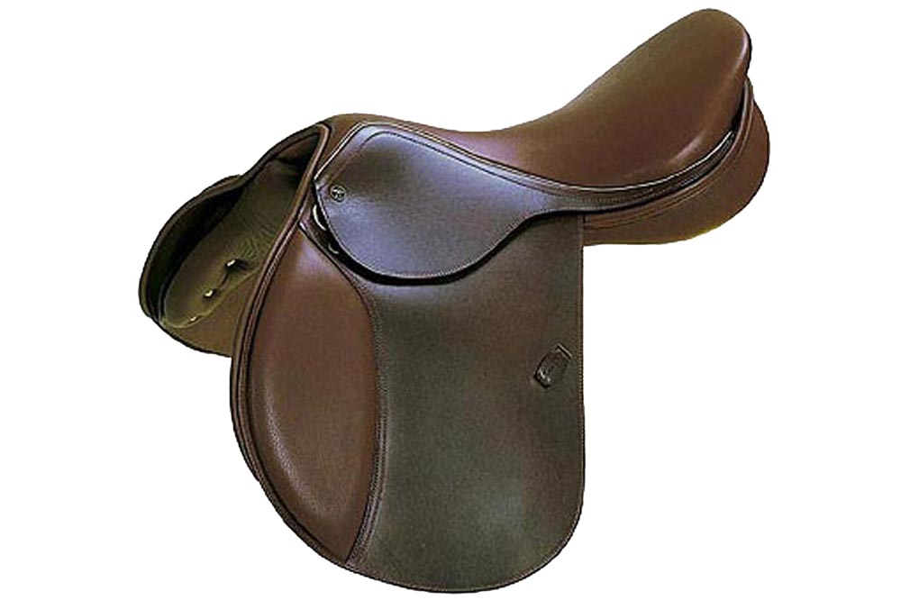
ARTICLE : ALL PURPOSE SADDLE (AP-019)
DES: BUFFALO LEATHER HARNESS WITH COW SOFTY SOFT PADDED, WOODEDN TREE
COLOUR : BLACK, BROWN , SIZE : 14”, 15” 16", 17" & 18"
FOB MUMBAI PRICE : USD - 70.00

Slide 21
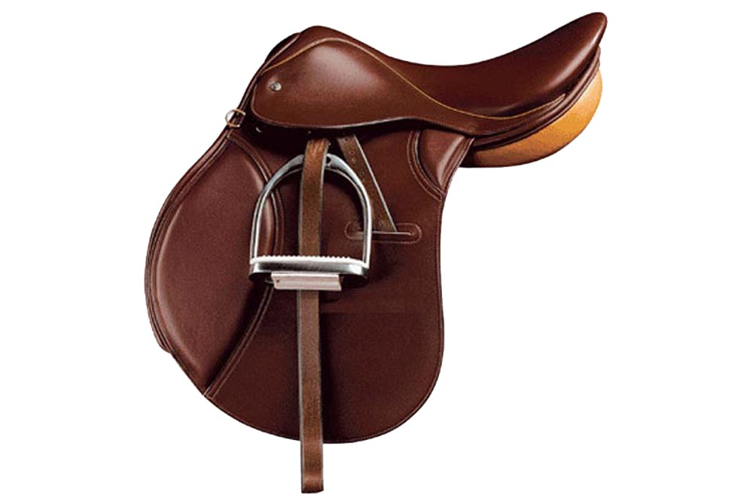
ARTICLE : ALL PURPOSE SADDLE (AP-020)
DES: BUFFALO LEATHER HARNESS WITH COW SOFTY SOFT PADDED, WOODEDN TREE
COLOUR : BLACK, BROWN, 14”, 15” 16", 17" & 18"
FOB MUMBAI PRICE : USD - 65.00

Slide 22
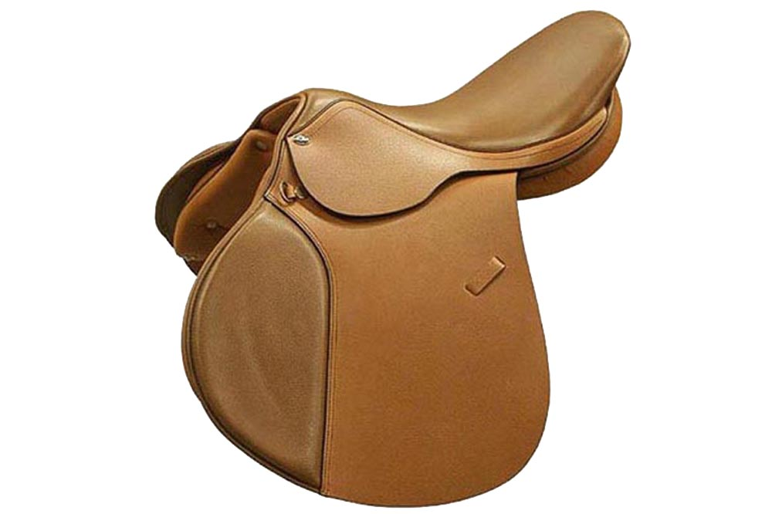
ARTICLE : ALL PURPOSE SADDLE (AP-021)
DES: BUFFALO LEATHER HARNESS WITH COW SOFTY SOFT PADDED, WOODEDN TREE
COLOUR : BLACK, BROWN, SIZE : 14”, 15” 16", 17" & 18"
FOB MUMBAI PRICE : USD - 65.00

Slide 23
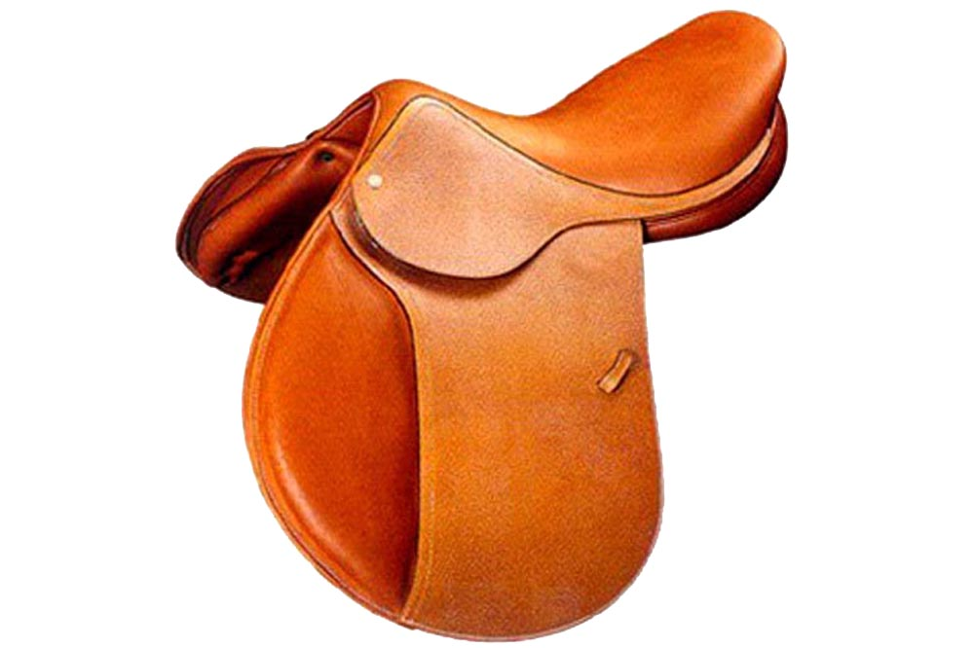
ARTICLE : LEATHER JUMPING SADDLE (JS-001)
DES: BUFFALO LEATHER HARNESS WITH COW SOFTY SOFT PADDED, WOODEDN TREE
COLOUR : BLACK, BROWN SIZE : 14”, 15” 16", 17" & 18"
FOB MUMBAI PRICE : USD - 65.00

Slide 24
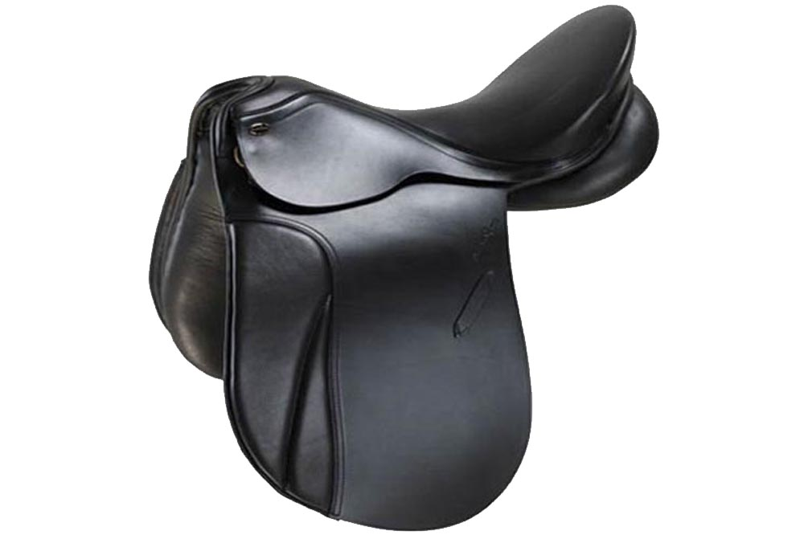
ARTICLE : LEATHER JUMPING SADDLE (JS-002)
DES: BUFFALO LEATHER HARNESS WITH COW SOFTY SOFT PADDED, WOODEDN TREE
COLOUR : BLACK, BROWN SIZE : 14”, 15” 16", 17" & 18"
FOB MUMBAI PRICE : USD - 75.00

Slide 25
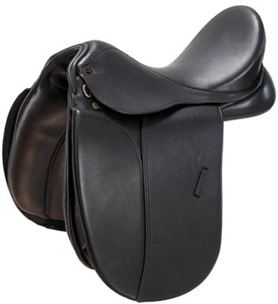
ARTICLE : LEATHER JUMPING SADDLE (JS-003)
DES: BUFFALO LEATHER HARNESS WITH COW SOFTY
SOFT PADDED, WOODEDN TREE WITH WHIT STITCHING OVERALL COLOUR : BLACK, BROWN, SIZE : 14”, 15” 16", 17" & 18"
FOB MUMBAI PRICE : USD - 75.00

Slide 26
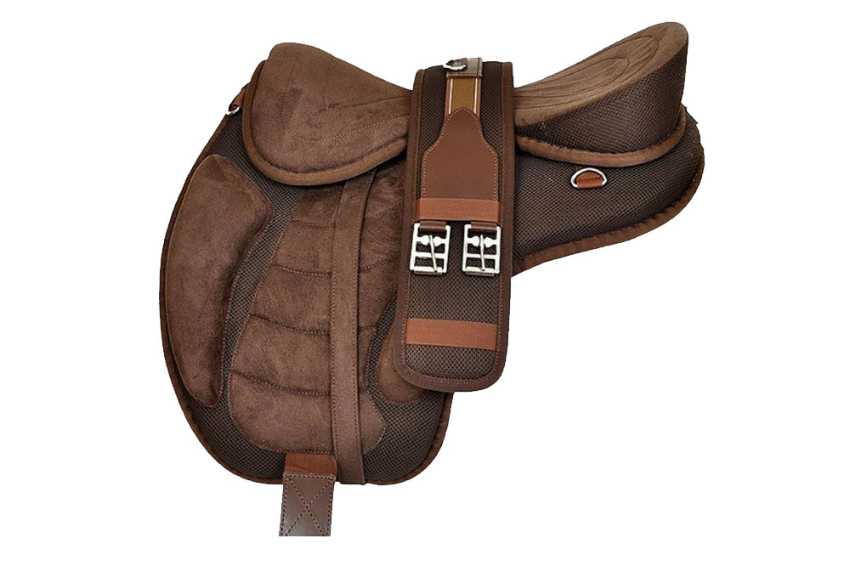
SYNTHETIC FREEMAX TREELESS HORSE SADDLE (FMX-001)
Finest Quality Treeless Saddle made up of High Quality Soft & Washable Synthetic Suede PU Moulded Seats and Flaps, No Hard Components Detachable Seat with Velcro System. Comes with Changeable Wither Iron Arch so can be Fitted on Variety of Horses. Detachable Stirrups Straps, Attached E Bars, Riders can Change on
His Comfortable Position. Underside Fix Panels Provide Comfort to Horse. Light weight approx. 2 kg.
We are giving professionally machine stitching (image attached) which gives long product life. COLOUR : BLACK, BROWN SIZE : 14', 16", 17" & 18"
FOB MUMBAI PRICE : USD - 35.00

Slide 27
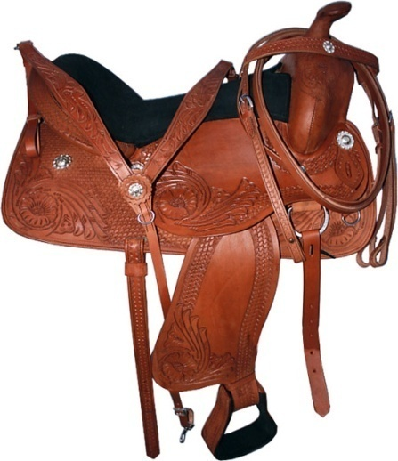
ARTICLE : WESTERN LEATHER SADDLE (WS-001)
LEATHER WESTERN MOUNTAIN SADDLE WITH FULL CARVED DES: LEATHER WESTERN MOUNTAIN
SADDLE WITH CARVIN & SS FITTING, STRONGER FIBRE TREE WITH HARD SHEET
COLOUR : BLACK, BROWN, NATURAL & TAN, SIZE : 12",13"14" & 16",17" & 18"
FOB MUMBAI PRICE : USD - 125.00

Slide 28
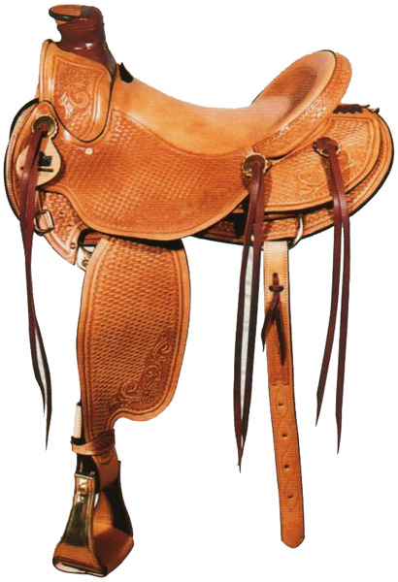
ARTICLE : WESTERN LEATHER SADDLE (WS-002)
LEATHER WESTERN SADDLE WITH HALF CARVED DES: LEATHER WESTERN SADDLE WITH
CARVIN & SS FITTING, STRONGER FIBRE TREE WITH SOFTY SHEET
COLOUR : BLACK, BROWN, NATURAL & TAN, SIZE : 12",13"14" & 16",17" & 18"
FOB MUMBAI PRICE : USD - 120.00

Slide 29
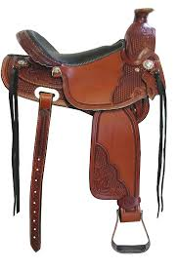
ARTICLE : WESTERN LEATHER SADDLE (WS-003)
LEATHER WESTERN MOUNTAIN SADDLE WITH FULL CARVED DES: LEATHER WESTERN MOUNTAIN SADDLE WITH CARVIN & SS FITTING, STRONGER FIBRE TREE WITH HARD SHEET COLOUR : BLACK, BROWN, NATURAL & TAN, SIZE : 12",13"14" & 16",17" & 18"
FOB MUMBAI PRICE : USD - 120.00

Slide 30
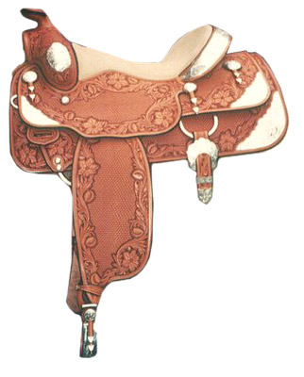
ARTICLE : WESTERN LEATHER SADDLE (WS-004)
LEATHER WESTERN SADDLE WITH FULL DIE EMBOSSED
DES: LEATHER WESTERN SADDLE WITH FULL DIE EMBOSSED & SILVER FITTING OVERALL WITH SILVER CONCHOS, STRONGER FIBRE TREE WITH SOFTY SHEET
COLOUR : BLACK, BROWN, NATURAL & TAN, SIZE : 12",13"14" & 16",17" & 18"
FOB MUMBAI PRICE : USD - 135.00

Slide 31
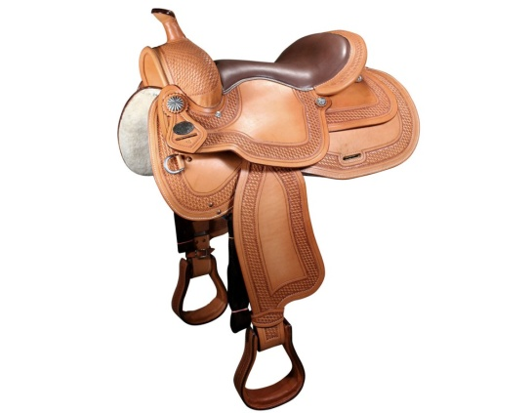
ARTICLE : WESTERN LEATHER SADDLE (WS-005)
LEATHER WESTERN SADDLE WITH FULL DIE EMBOSSED
DES: LEATHER WESTERN SADDLE WITH FULL DIE EMBOSSED & SILVER FITTING OVERALL WITH SILVER CONCHOS, STRONGER FIBRE TREE WITH SOFTY SHEET COLOUR : BLACK, BROWN, NATURAL & TAN, SIZE : 12",13"14" & 16",17" & 18"
FOB MUMBAI PRICE : USD - 125.00

Slide 32
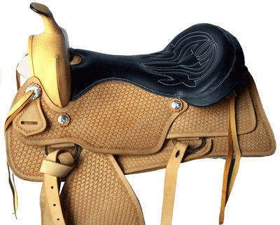
ARTICLE : WESTERN LEATHER SADDLE (WS-006)
LEATHER WESTERN SADDLE WITH FULL DIE EMBOSSED
DES: LEATHER WESTERN SADDLE WITH FULL DIE EMBOSSED & SILVER FITTING OVERALL WITH SILVER CONCHOS, STRONGER FIBRE TREE WITH SOFTY SHEET COLOUR : BLACK, BROWN, NATURAL & TAN, SIZE : 12",13"14" & 16",17" & 18"
FOB MUMBAI PRICE : USD - 120.00

Slide 33
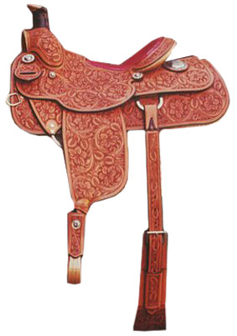
ARTICLE : WESTERN LEATHER SADDLE (WS-008)
LEATHER WESTERN MOUNTAIN SADDLE WITH FULL CARVED DES: LEATHER WESTERN MOUNTAIN SADDLE WITH CARVIN & SS FITTING, STRONGER FIBRE TREE WITH HARD SHEET COLOUR : BLACK, BROWN, NATURAL & TAN, SIZE : 12",13"14" & 16",17" & 18"
FOB MUMBAI PRICE : USD - 135.00

