Slide 1

ARREOS INTERNATIONAL
88/384 (3) Overseas Compound, Humanyun Bagh, Kanpur 208001, Uttar Pardesh – INDIA
e-mail: info@arreosinternational.com, web: www.arreosinternational.com

Slide 2
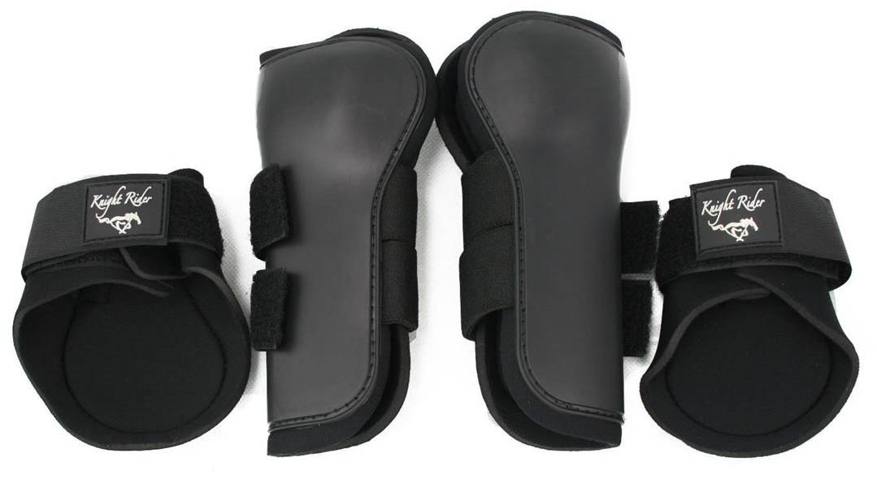
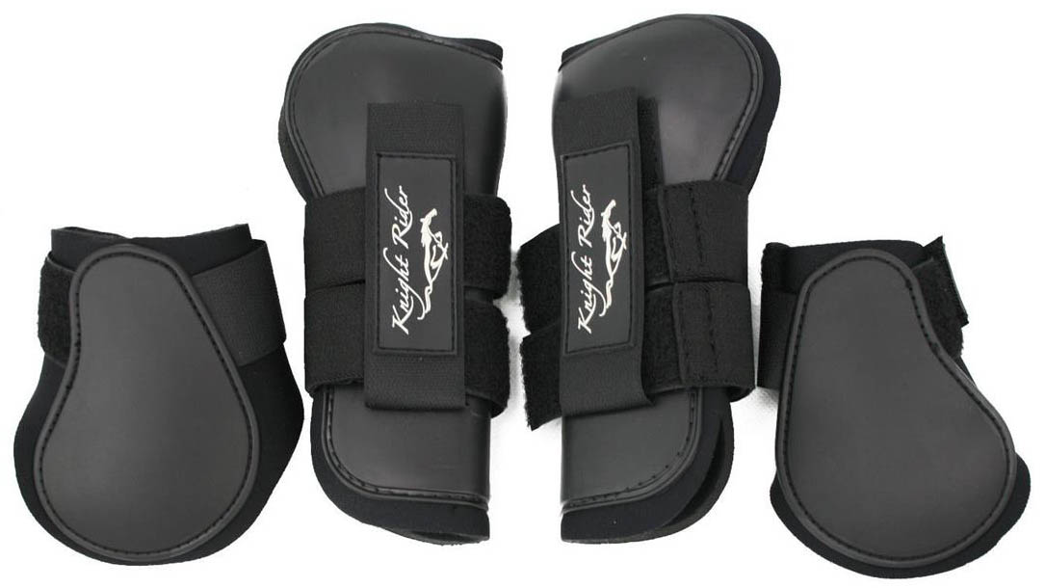
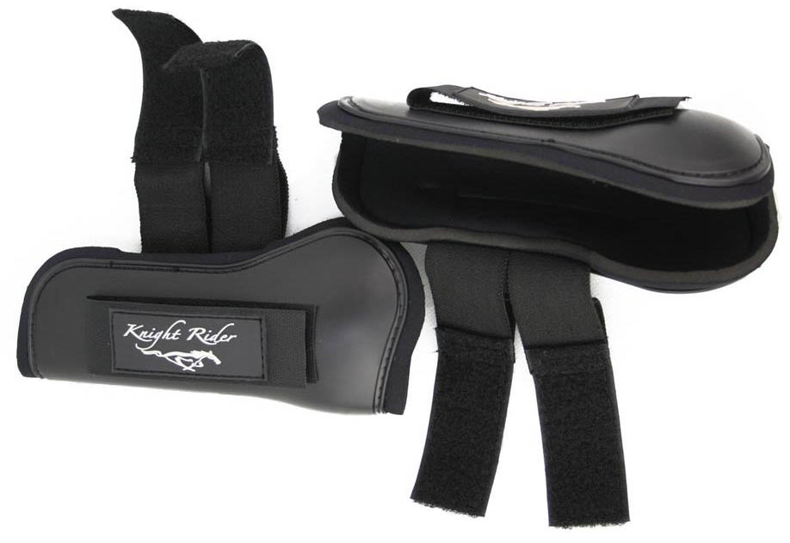
Description : Tendon Boot TB-0011
Durable outer material Shell: TPU plastic.
Neoprene lining
Pretty colours
Striped hook-and-loop closure
Colour: Black, Brown, Beetle Khaki Green, Gray, Purple
Price Fob Mumbai Port, India: $14.00 per set Including Proper Branding and Packaging.
MOQ: 50 Set in each style & colour
Knight Rider is our own brand and we can provide you the same if required.

Slide 3
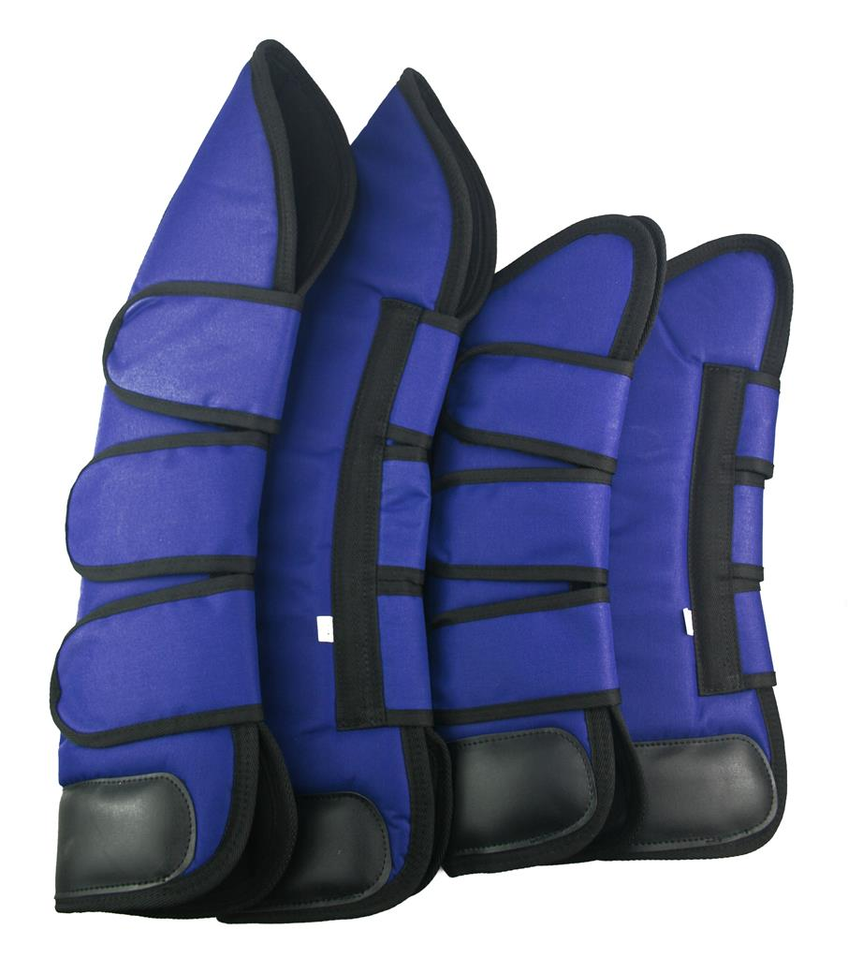
Travel Boot-0012
Durable and strong 1000 Denier, Ballistic nylon outer protection with dense foam inner and nylon lining for comfort protective microfibre bottom layer shields against cuts to the pastern area.
Filling draws away moisture and sweat quick dry lining
Easy to put on and take off with secure Velcro straps
Set includes 4 boots (2 x front and 2 x hind)
Price Fob Mumbai Port, India: $16.50 per set Including Proper Branding and Packaging.
MOQ: 50 Set in each style & colour.

Slide 4
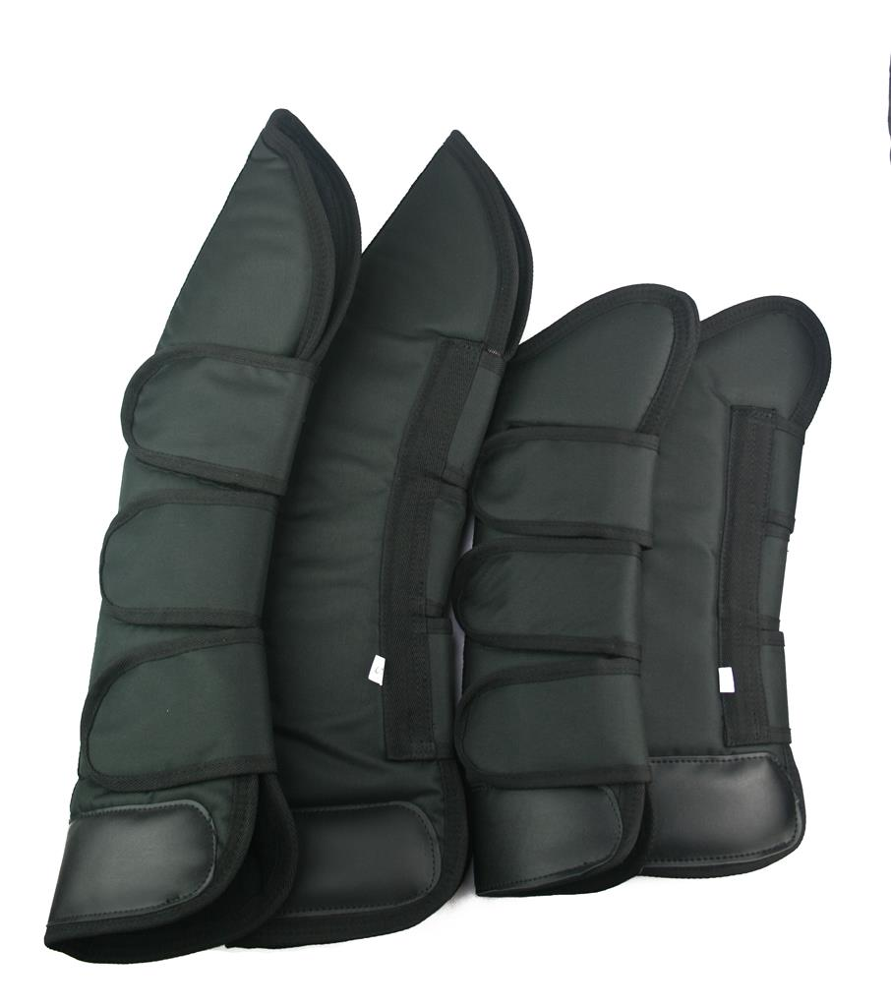
Travel Boot-0012
Durable and strong 1000 Denier, Ballistic nylon outer protection with dense foam inner and nylon lining for comfort protective microfibre bottom layer shields against cuts to the pastern area.
Filling draws away moisture and sweat quick dry lining
Easy to put on and take off with secure Velcro straps
Set includes 4 boots (2 x front and 2 x hind)
Price Fob Mumbai Port, India: $16.50 per set Including Proper Branding and Packaging.
MOQ: 50 Set in each style & colour.

Slide 5
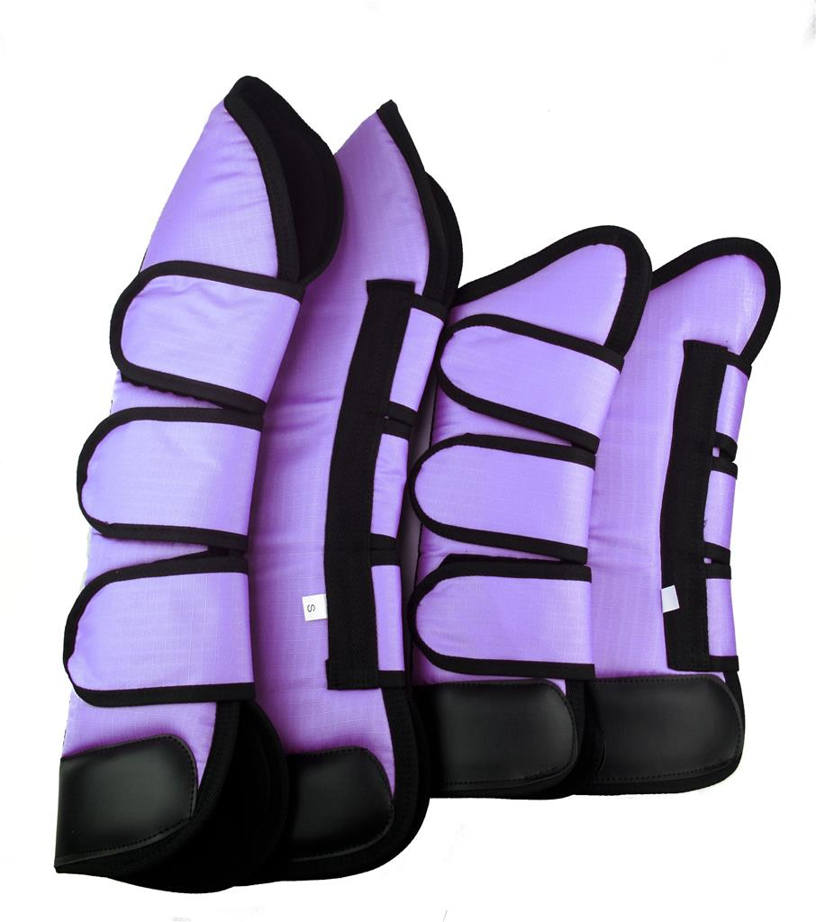
Travel Boot-0012
Durable and strong 1000 Denier, Ballistic nylon outer protection with dense foam inner and nylon lining for comfort protective microfibre bottom layer shields against cuts to the pastern area.
Filling draws away moisture and sweat quick dry lining
Easy to put on and take off with secure Velcro straps
Set includes 4 boots (2 x front and 2 x hind)
Price Fob Mumbai Port, India: $16.50 per set Including Proper Branding and Packaging.
MOQ: 50 Set in each style & colour.

Slide 6
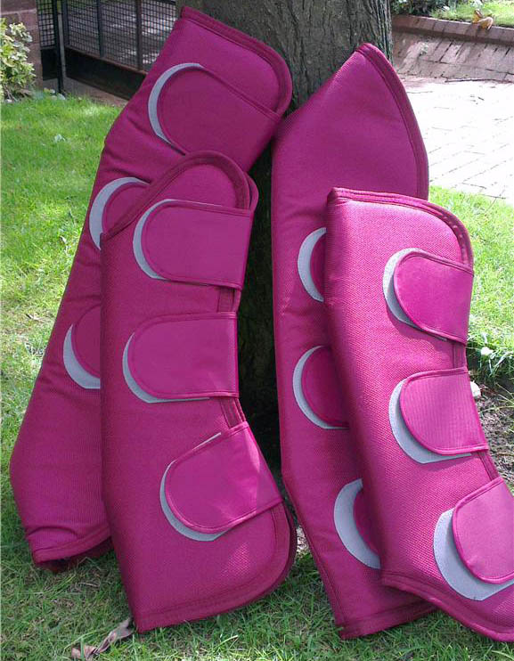
Travel Boot-0012
Durable and strong 1000 Denier, Ballistic nylon outer protection with dense foam inner and nylon lining for comfort
protective microfibre bottom layer shields against cuts to the pastern area.
Filling draws away moisture and sweat quick dry lining
Easy to put on and take off with secure Velcro straps
Set includes 4 boots (2 x front and 2 x hind)
Price Fob Mumbai Port, India: $16.50 per set Including Proper Branding and Packaging.
MOQ: 50 Set in each style & colour.

Slide 7
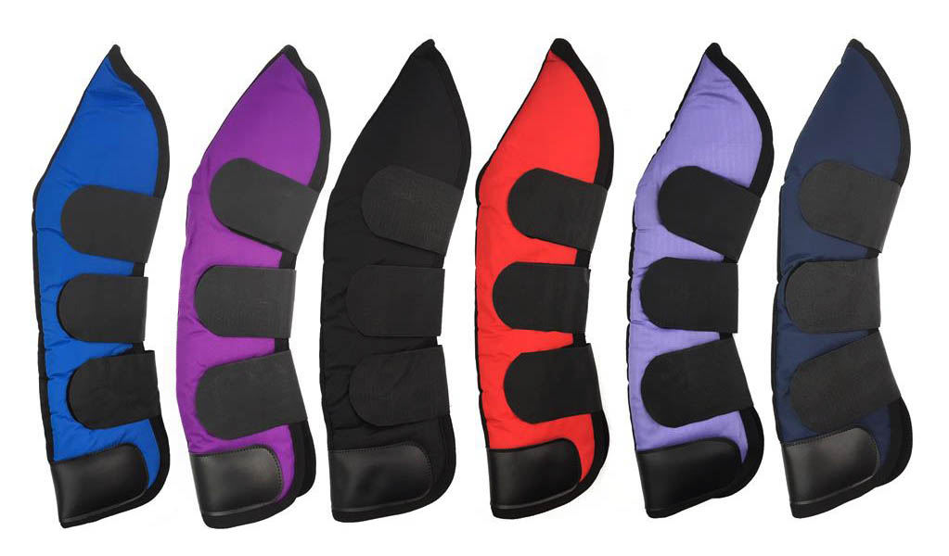
Travel Boot-0012
Durable and strong 1000 Denier, Ballistic nylon outer protection with dense foam inner and nylon lining for comfort protective microfibre bottom layer shields against cuts to the pastern area.
Filling draws away moisture and sweat quick dry lining
Easy to put on and take off with secure Velcro straps
Set includes 4 boots (2 x front and 2 x hind)
Price Fob Mumbai Port, India: $16.50 per set Including Proper Branding and Packaging.
MOQ: 50 Set in each style & colour.

