Slide 1

ARREOS INTERNATIONAL
A88/384 (3) Overseas Compound, Humanyun Bagh, Kanpur 208001, Uttar Pardesh – INDIA
e-mail: info@arreosinternational.com, web: www.arreosinternational.com
web: www.arreosinternational.com

Slide 2
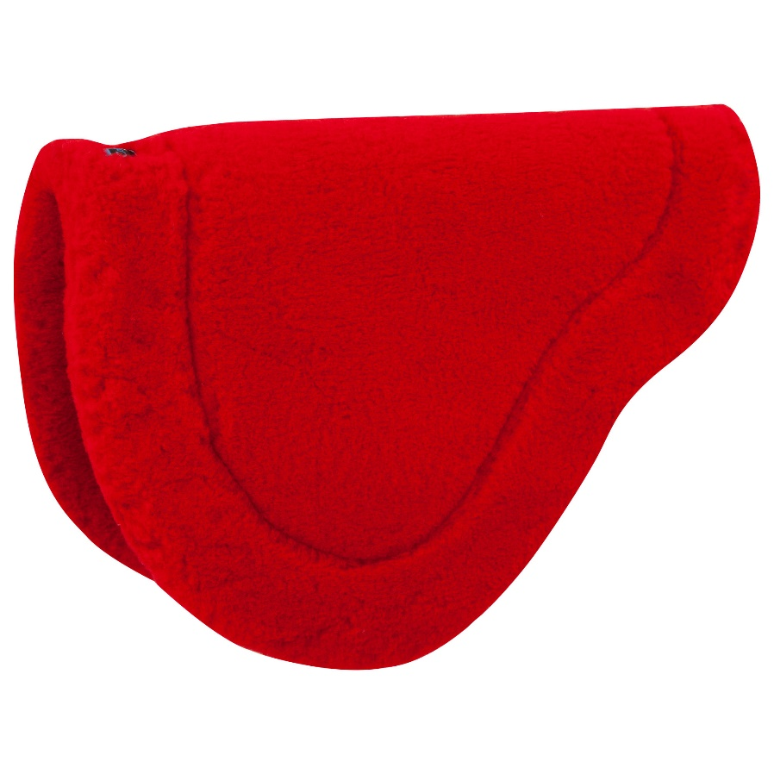
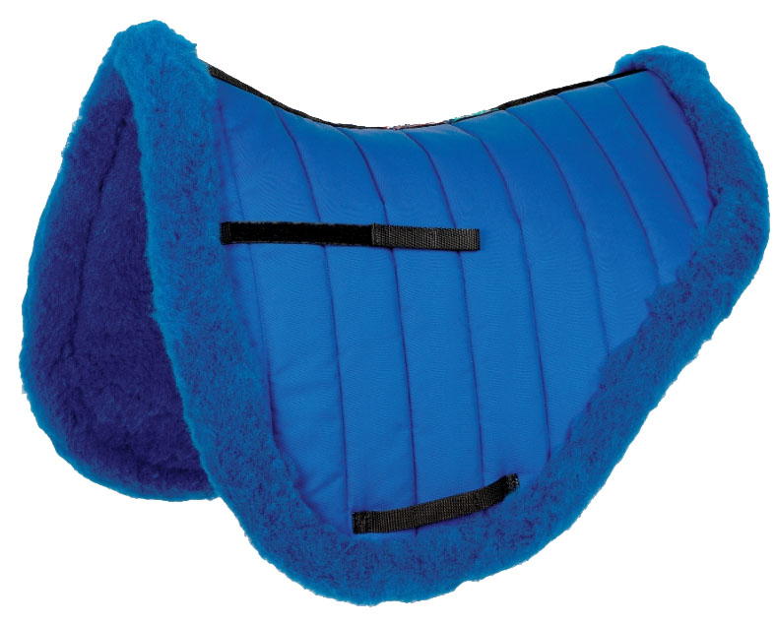
Description: Fleece Saddle pad
Colour: White, Black, Blue, Pink, Red, Brown Size: Pony-Cob-Full
This Saddle Pad is manufactured from Fleece Fabric High Quality Mink/Furr and 16mm Padding (Status).
Shiny outer fabric, Girth and saddle loops Anatomically shaped, Breathable lining
Price: USD 12.00 Ex Factory

Slide 3
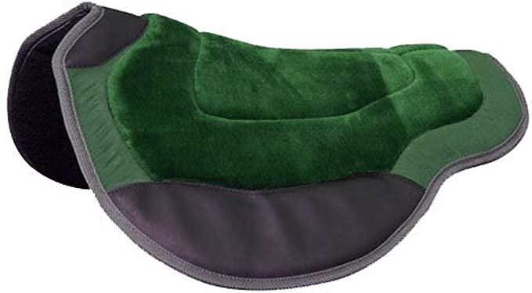
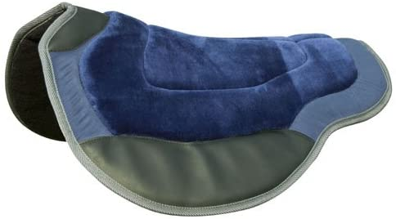
Description: Quilted Ploy-Cotton Saddle pad
Colour: White, Black, Blue, Pink, Red, Brown, Green Size: Pony-Cob-Full
Shaped Endurance Pad Real wool bottom, Pinnacle fleece saddle tree area, Synthetic suede and rugged wear leathers.
Price: USD 10.00 Ex Factory

Slide 4
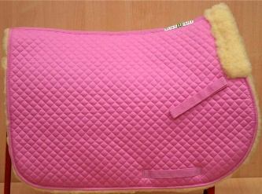
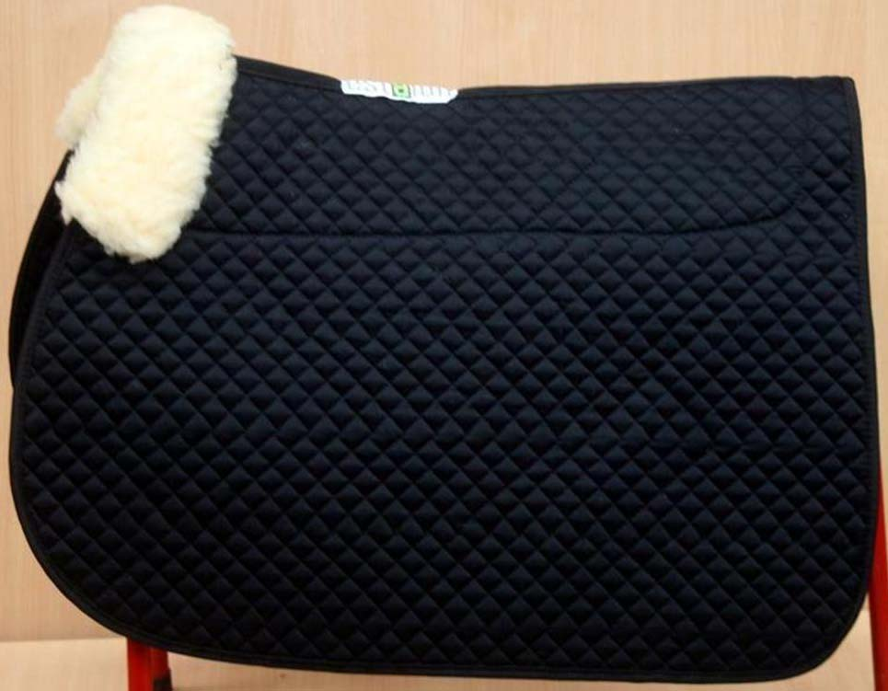
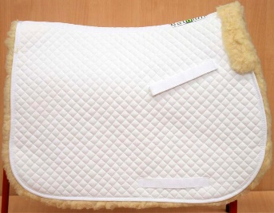
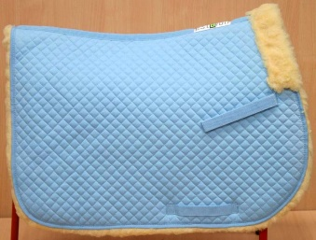
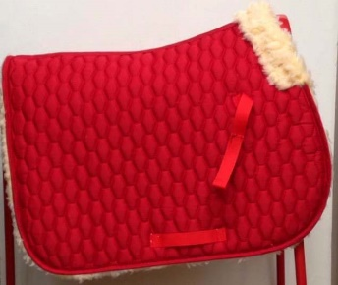
Description: Faux Sheepskin Full Fleece Saddle pad
Colour: Black-Pink-Blue-White, Size: Full-Cob-Pony
A quality faux sheepskin full fleece saddle pad, provides an extra soft layer between the horses back and the saddle. Choice of 5 Colours. Red, Black, White, Sky Blue, Pink.
Price: USD 14.00 Ex Factory

Slide 5
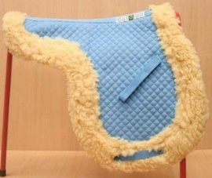
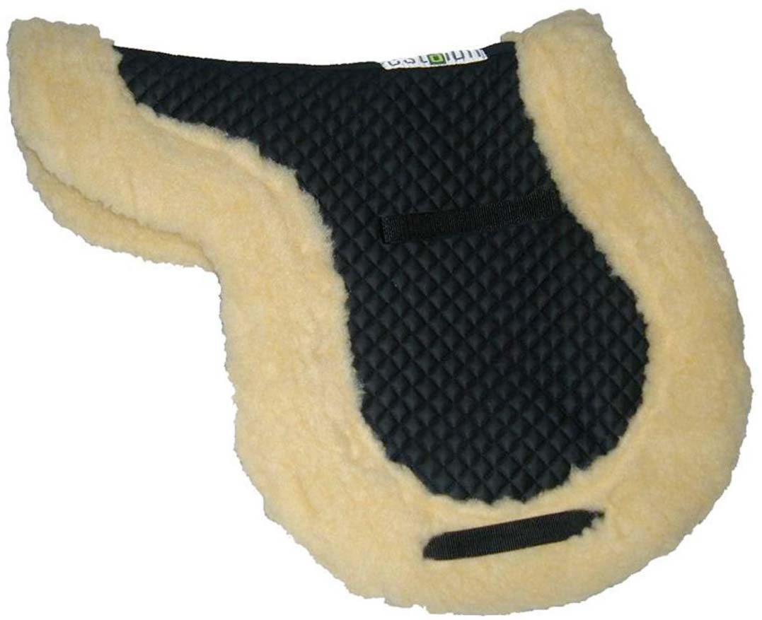
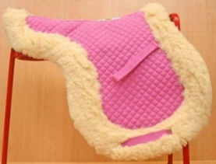
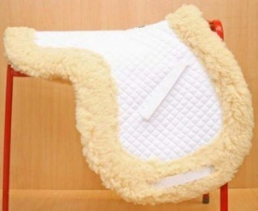
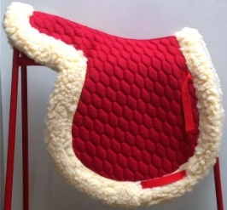
Description: Faux Sheepskin Fleece Numnah
Colour: Black-Pink-Blue-White-Red, Size: Pony-Full
A quality faux sheepskin fleece numnah, provides an extra soft layer between the horses back and the saddle. also comes with girth 2 straps to keep it in place.
Price: USD 13.00 Ex Factory

Slide 6
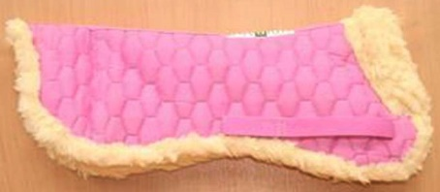
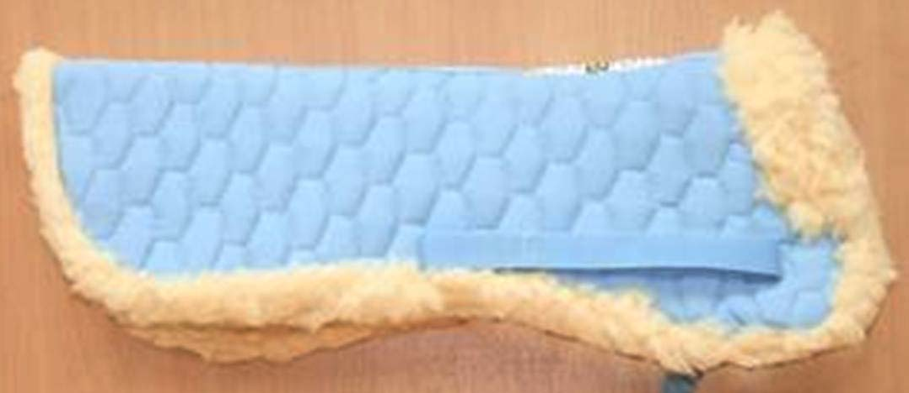
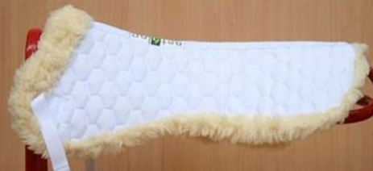
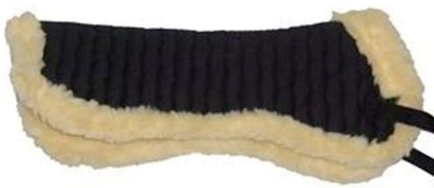
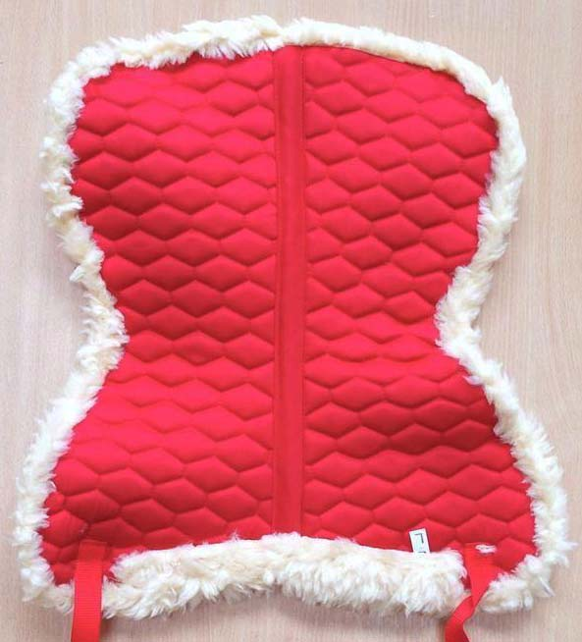
Description: Highlander Turnout Rug
A quality faux sheepskin full fleece saddle pad, provides an extra soft layer between the horses back and the saddle. Choice of 5 Colours. Red, Black, White, Sky Blue, Pink. Size: All Size
Price: USD 8.00 Ex Factory

Slide 7
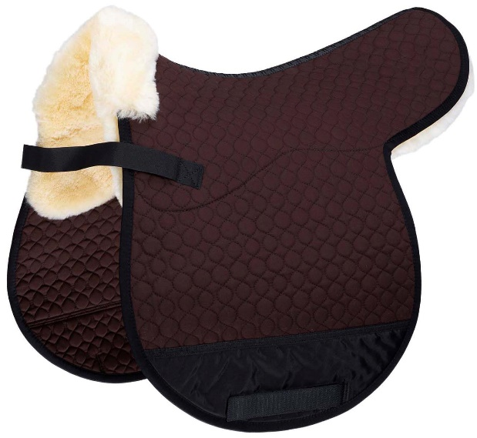
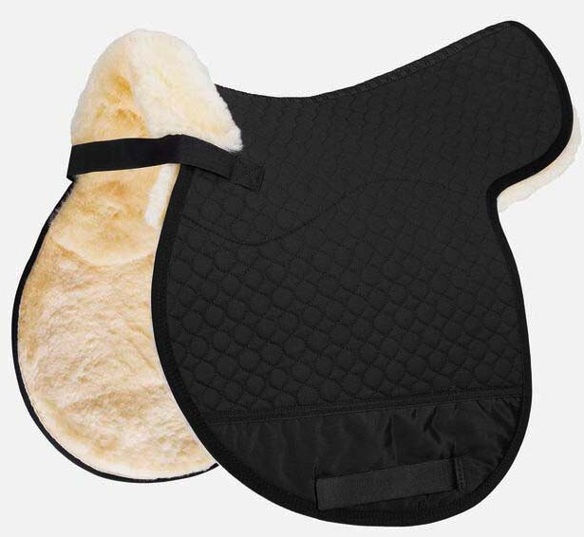
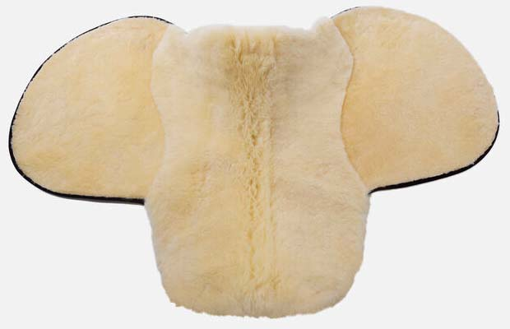
Description: Original Imported Sheepskin with Fleece Numnah
Colour: Black-Brown, Pink-Blue-White-Red, Size: Pony-Full
A quality faux sheepskin fleece numnah, provides an extra soft layer between the horses back and the saddle. also comes with girth 2 straps to keep it in place.
Price: USD 35.00 Ex Factory

Slide 8
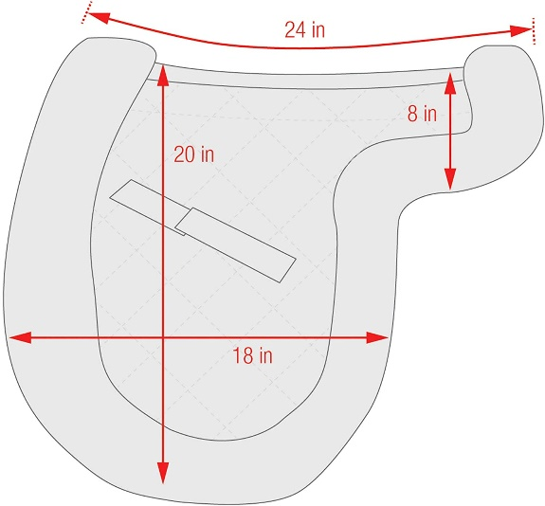
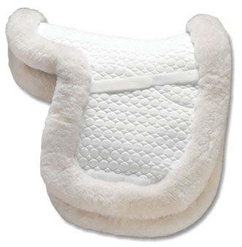
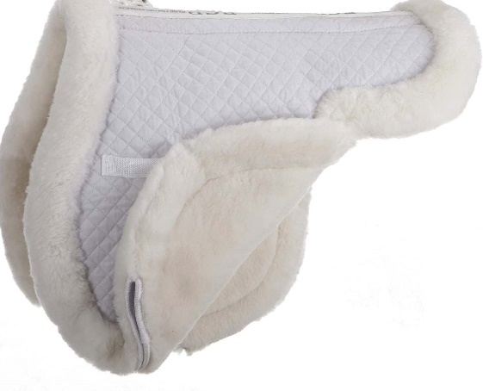
Description: Original Imported Sheepskin with Fleece Numnah
Colour: Black-Brown, Pink-Blue-White-Red, Size: Pony-Full
A quality faux sheepskin fleece numnah, provides an extra soft layer between the horses back and the saddle. also comes with girth 2 straps to keep it in place.
Price: USD 35.00 Ex Factory

Slide 9
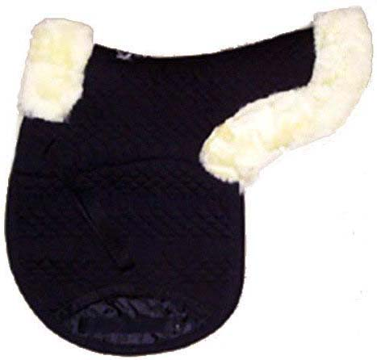
Description: Original Imported Sheepskin Fleece Numnah
Colour: Black-Brown, Pink-Blue-White-Red, Size: Pony-Full
A quality faux sheepskin fleece numnah, provides an extra soft layer between the horses back and the saddle. also comes with girth 2 straps to keep it in place.
Price: USD 32.00 Ex Factory

Slide 10
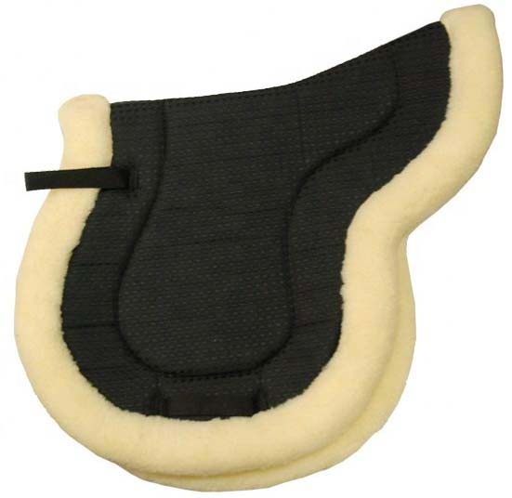
Description: Original Sheepskin Fleece Numnah
Colour: Black-Brown, Pink-Blue-White-Red, Size: Pony-Full
A quality faux sheepskin fleece numnah, provides an extra soft layer between the horses back and the saddle. also comes with girth 2 straps to keep it in place.
Price: USD 33.00 Ex Factory

Slide 11
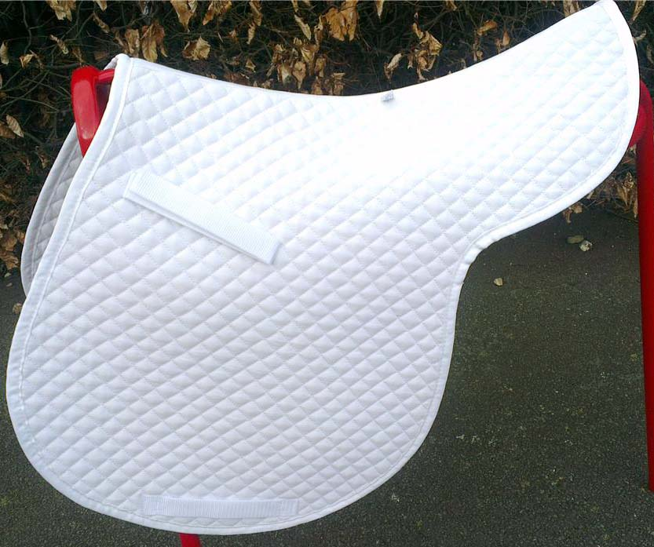
Description: Quilted cotton Saddle pad
Colour: White, Black, Blue, Pink, Red, Brown Size: Pony-Full
A quality saddle pad is cotton quilted, ideal for everyday use but stylish enough for competition.
Girth and saddle loops Anatomically shaped, Breathable lining
Price: USD 8.50 Ex Factory

Slide 12
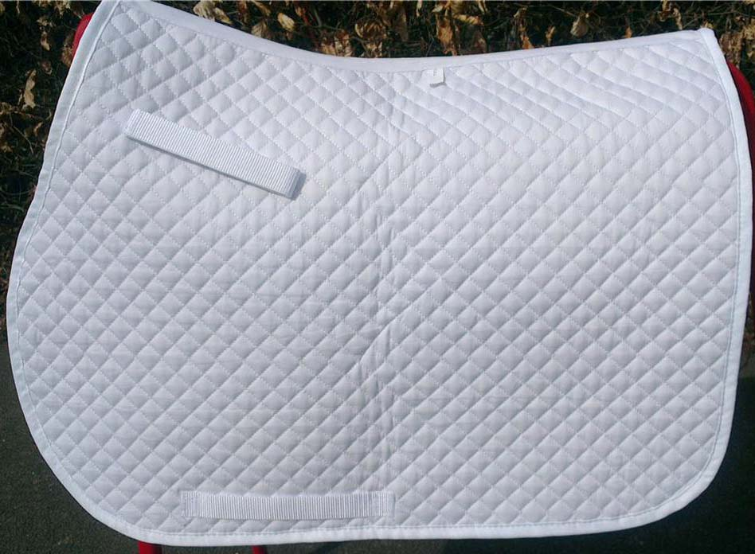
Description: Quilted cotton Saddle pad
Colour: White, Black, Blue, Pink, Red, Brown Size: Pony-Full
A quality saddle pad is cotton quilted, ideal for everyday use but stylish enough for competition.
Girth and saddle loops Anatomically shaped, Breathable lining.
Price: USD 9.00 Ex Factory

Slide 13
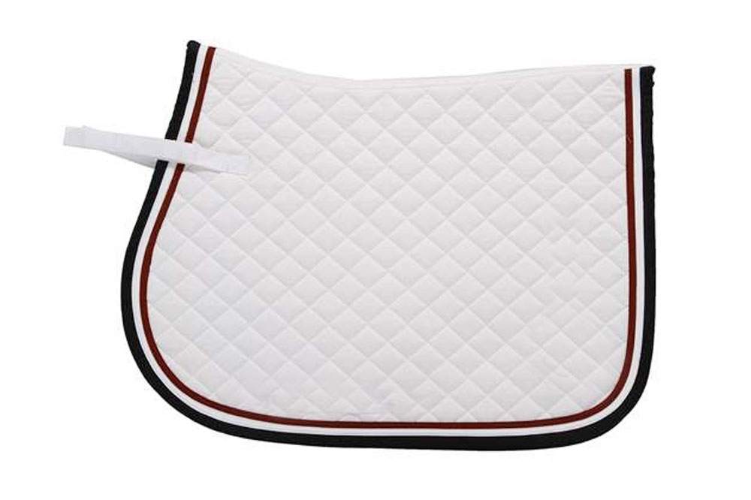
Description: Quilted Cotton Saddle Pad
Colour: White, Black, Blue, Pink, Red, Brown Size: Pony-Full
A quality saddle pad is cotton quilted, ideal for everyday use but stylish enough for competition.
Girth and saddle loops Anatomically shaped, Breathable lining.
Price: USD 9.00 Ex Factory

Slide 14
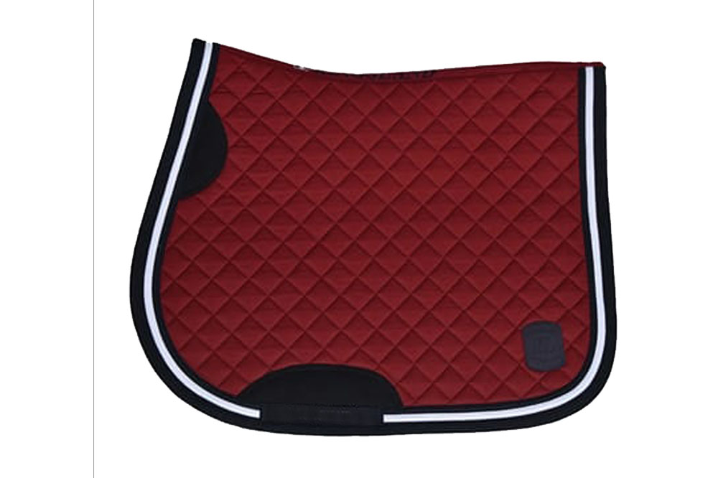
Description: Quilted Satin Saddle pad
Colour: White, Black, Blue, Pink, Red, Brown Size: Pony-Full
A quality saddle pad is cotton quilted, ideal for everyday use but stylish enough for competition.
Girth and saddle loops Anatomically shaped, Breathable lining
Price: USD 16.50 Ex Factory

Slide 15
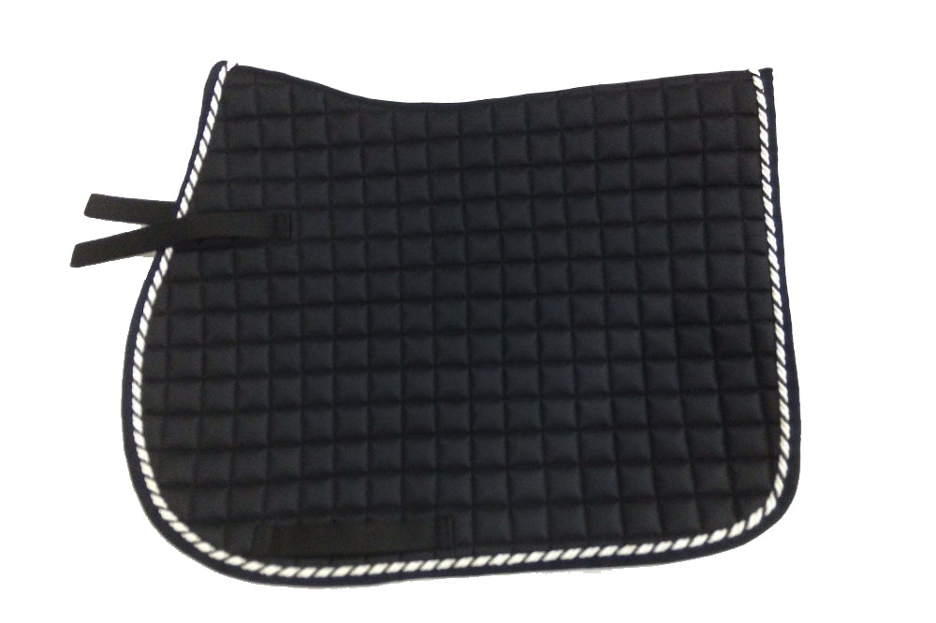
Description: Quilted Satin Saddle pad
Colour: White, Black, Blue, Pink, Red, Brown Size: Pony-Full
A quality saddle pad is cotton quilted, ideal for everyday use but stylish enough for competition.
Girth and saddle loops Anatomically shaped, Breathable lining
Price: USD 15.50 Ex Factory

Slide 16
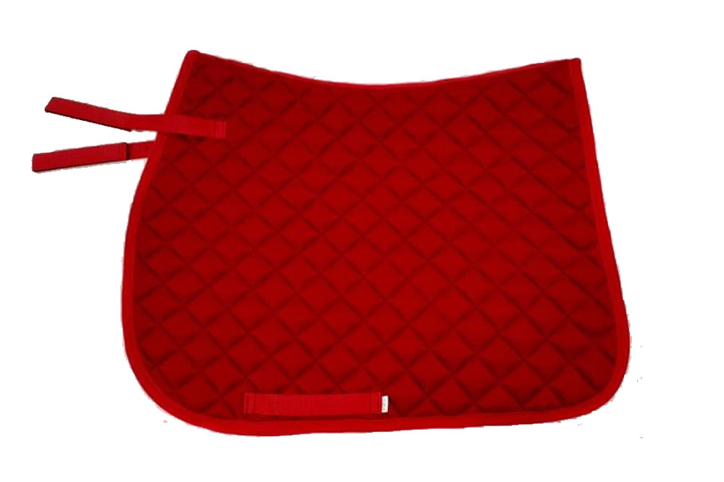
Description: Quilted Cotton Saddle pad
Colour: White, Black, Blue, Pink, Red, Brown Size: Pony-Full
A quality saddle pad is cotton quilted, ideal for everyday use but stylish enough for competition.
Girth and saddle loops Anatomically shaped, Breathable lining.
Price: USD 8.50 Ex Factory

Slide 17
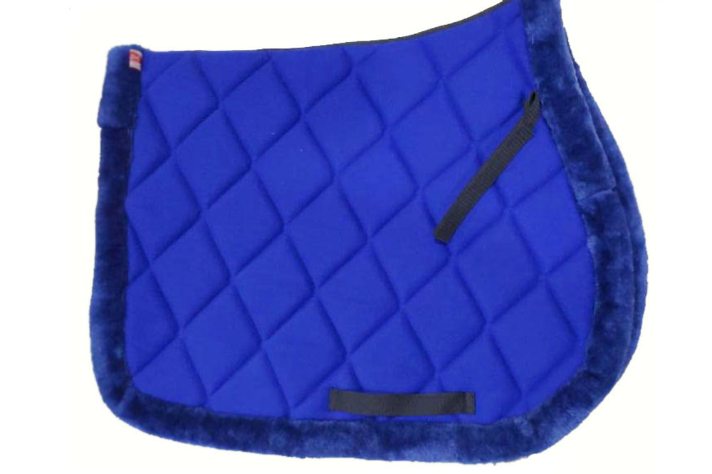
Description: Quilted Cotton With Mink Saddle pad
Colour: White, Black, Blue, Pink, Red, Brown Size: Pony-Full
A quality saddle pad is cotton quilted, ideal for everyday use but stylish enough for competition.
Girth and saddle loops Anatomically shaped, Breathable lining.
Price: USD 9.00 Ex Factory

Slide 18
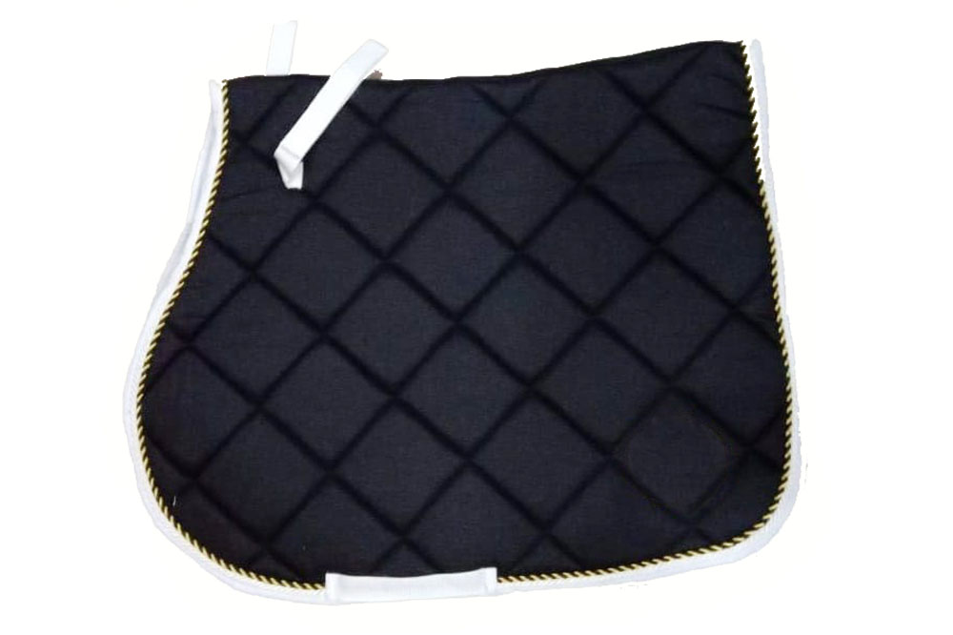
Description: Quilted Poly-Cotton Saddle pad
Colour: White, Black, Blue, Pink, Red, Brown Size: Pony-Full
A quality saddle pad is cotton quilted, ideal for everyday use but stylish enough for competition.
Girth and saddle loops Anatomically shaped, Breathable lining
Price: USD 10.50 Ex Factory

Slide 19
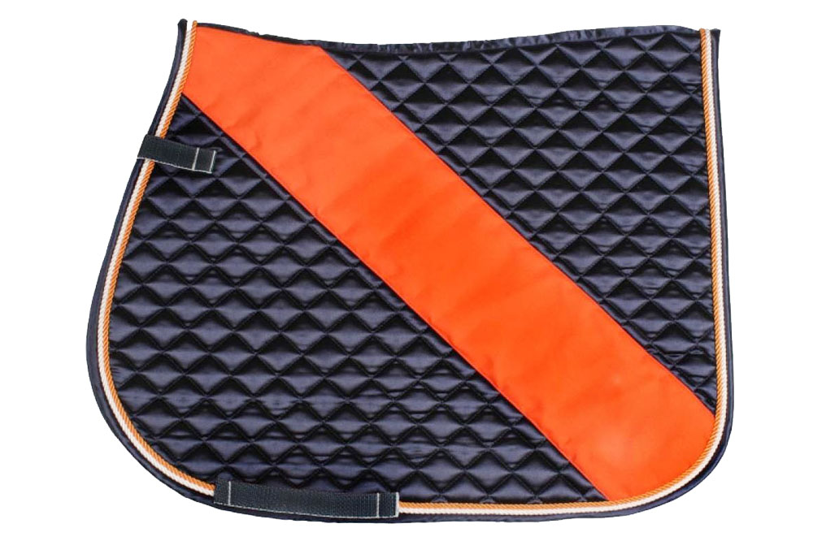
Description: Quilted Ploy-Satin Saddle Pad
Colour: White, Black, Blue, Pink, Red, Brown Size: Pony-Full
A quality saddle pad is cotton quilted, ideal for everyday use but stylish enough for competition.
Shiny outer fabric, Girth and saddle loops Anatomically shaped, Breathable lining
Price: USD 15.00 Ex Factory

Slide 20
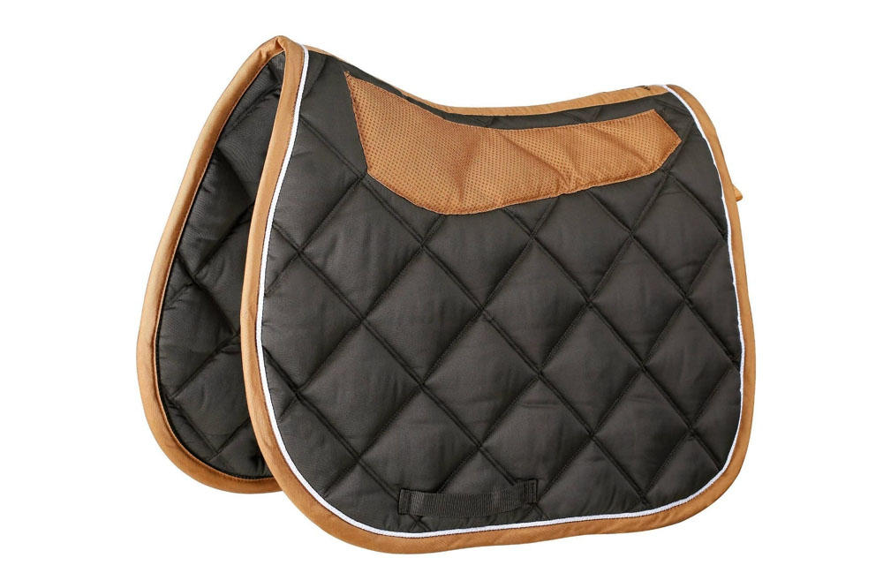
Description: Quilted Ploy-Cotton Saddle pad
Colour: White, Black, Blue, Pink, Red, Brown Size: Pony-Full
A quality saddle pad is cotton quilted, ideal for everyday use but stylish enough for competition.
Shiny outer fabric, Girth and saddle loops Anatomically shaped, Breathable lining
Price: USD 13.5.00 Ex Factory

